Slide 1
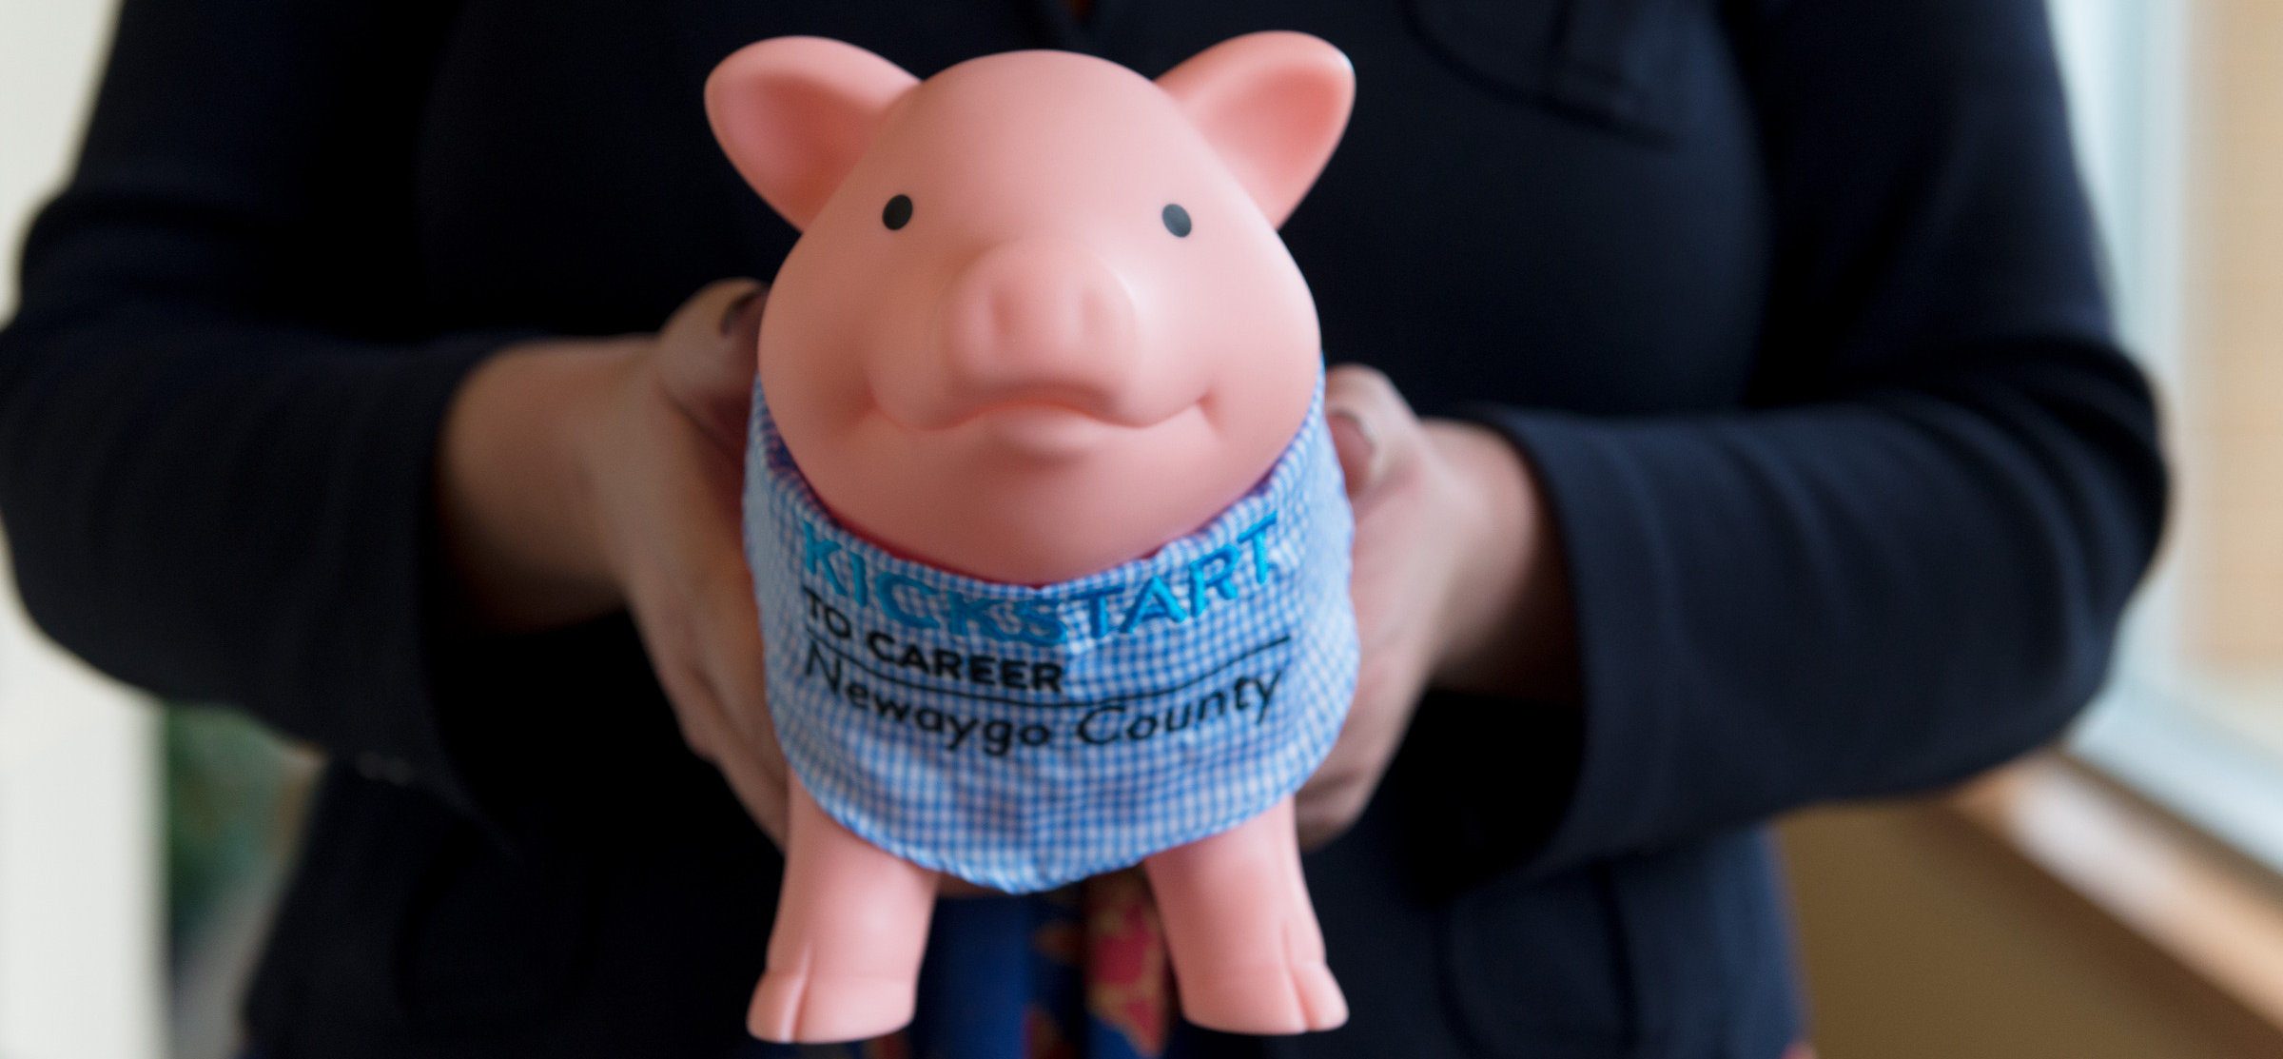

Grade 3
Notes:
(1) “Hello. My name is Mr./Ms./Mrs. ____.” You may use your fist name. Keep in mind that students are used to addressing adults in school as Mr., Ms., or Mrs.
Introduce the mascot “I am here today with Kickstart to Career Newaygo County. I have brought my friend, Penny the Piggy Bank.” (Show Penny to the students, welcome them to greet her.)

Slide 2


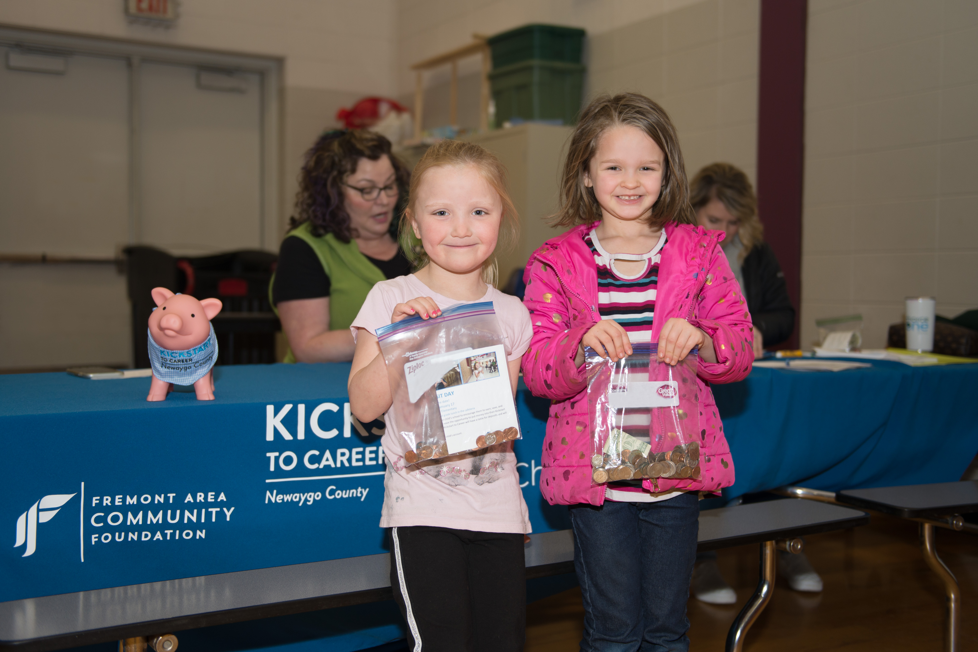
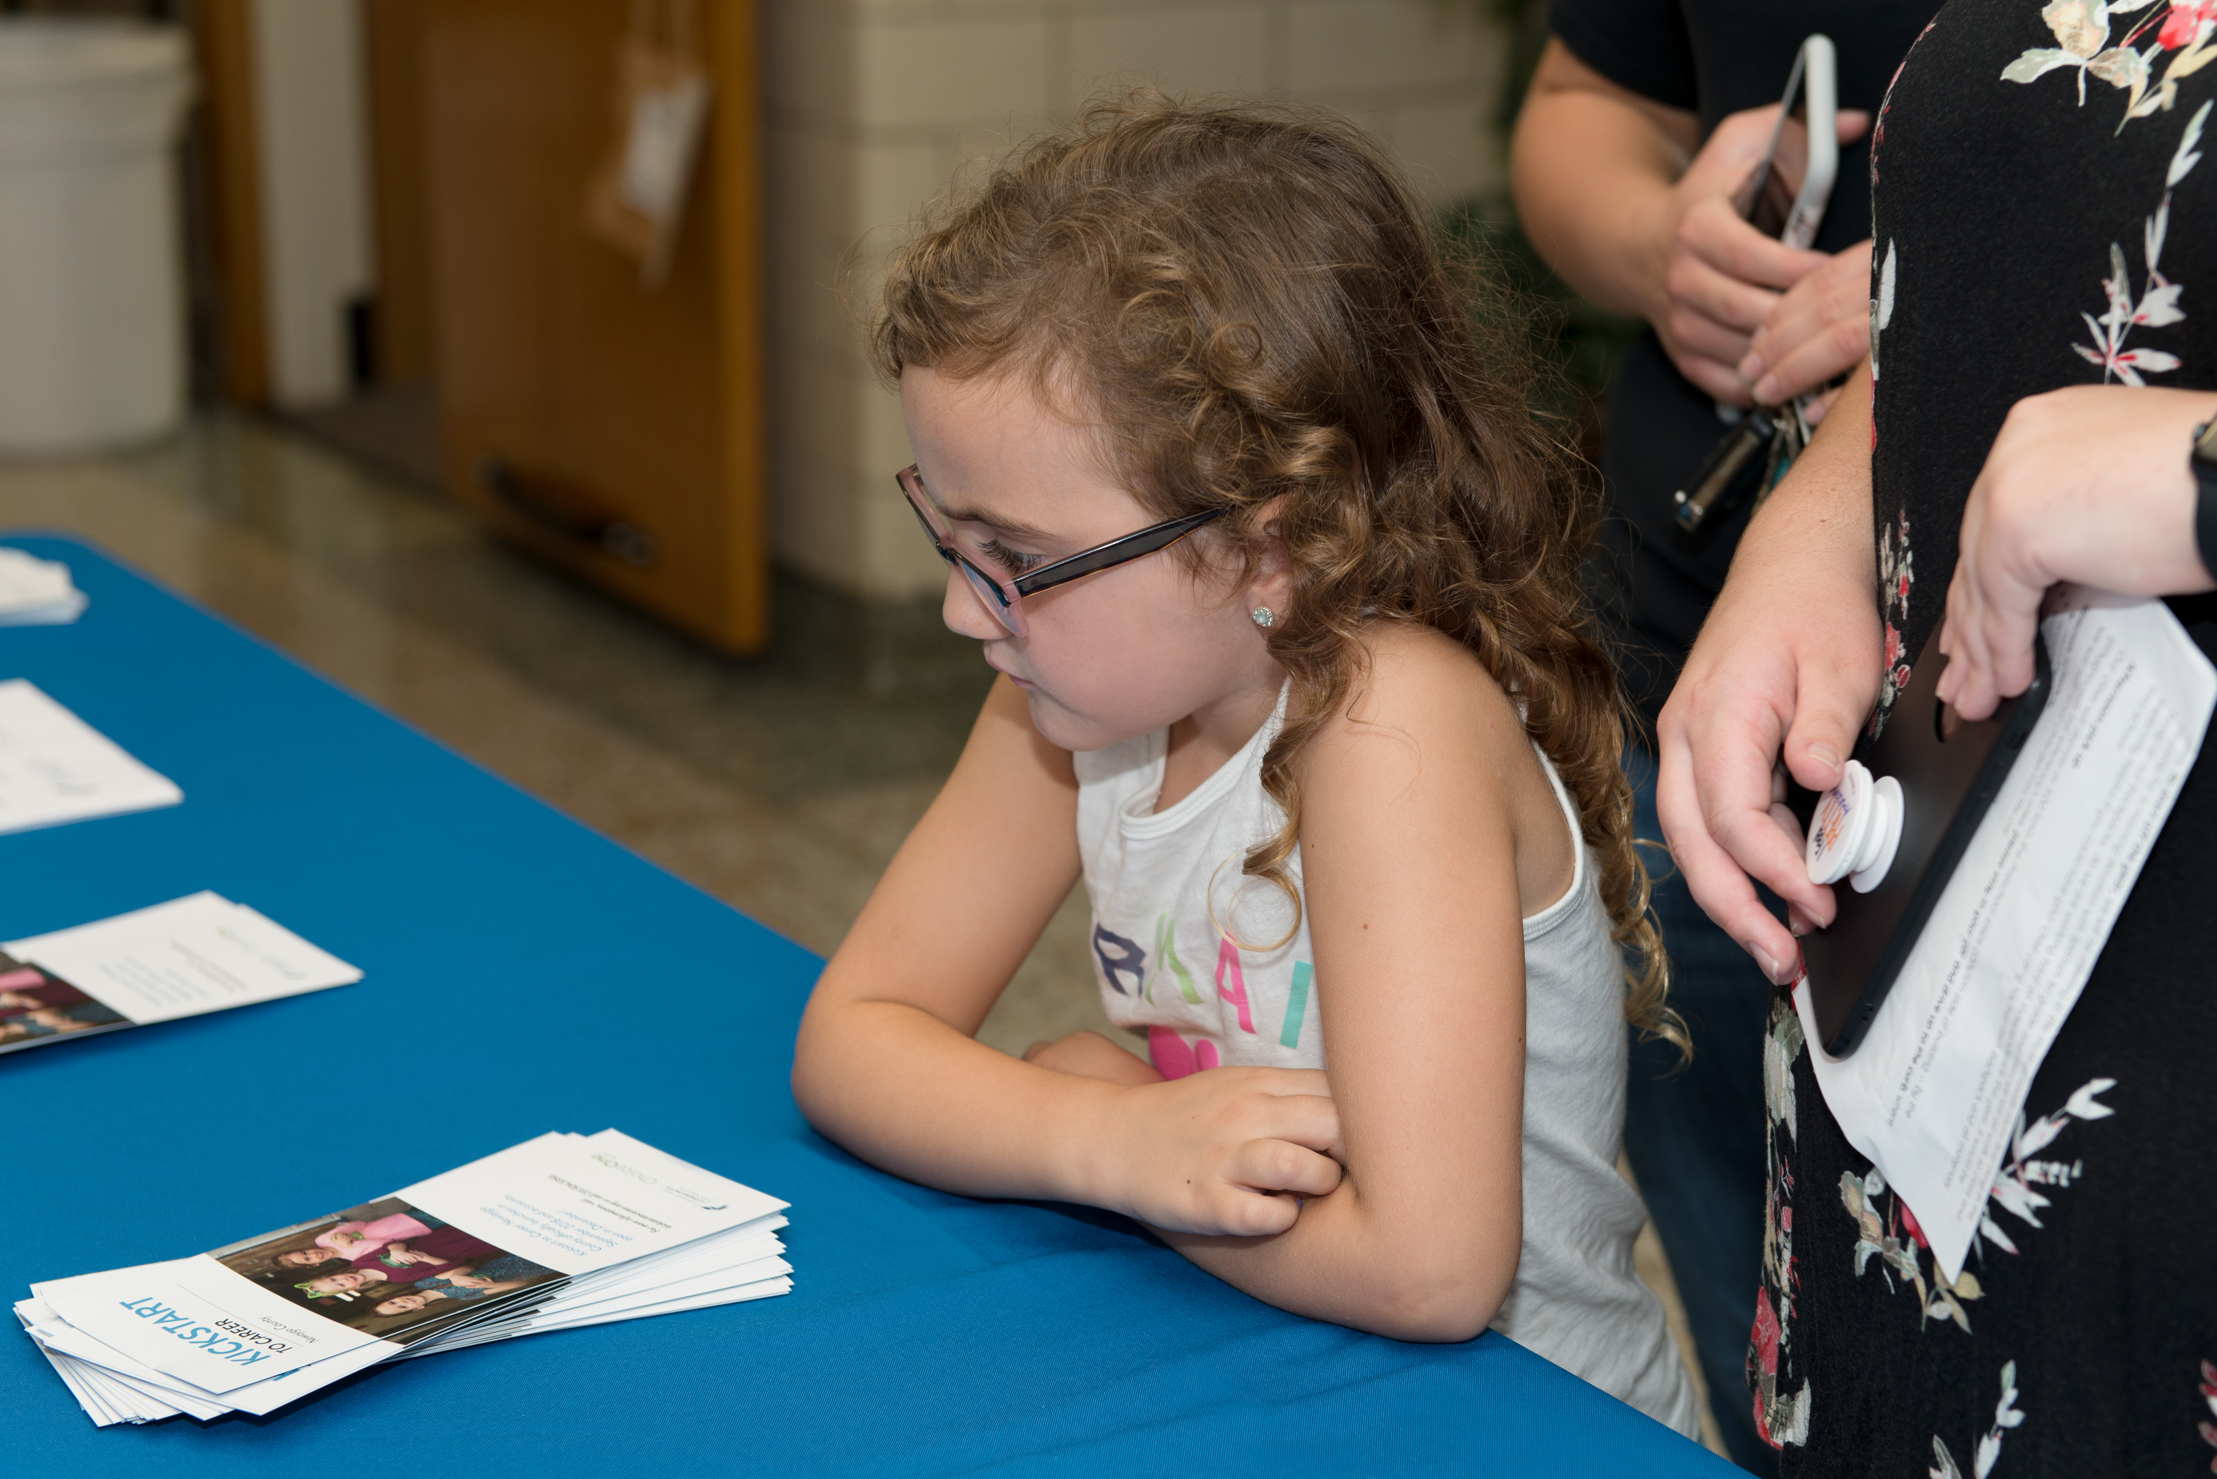
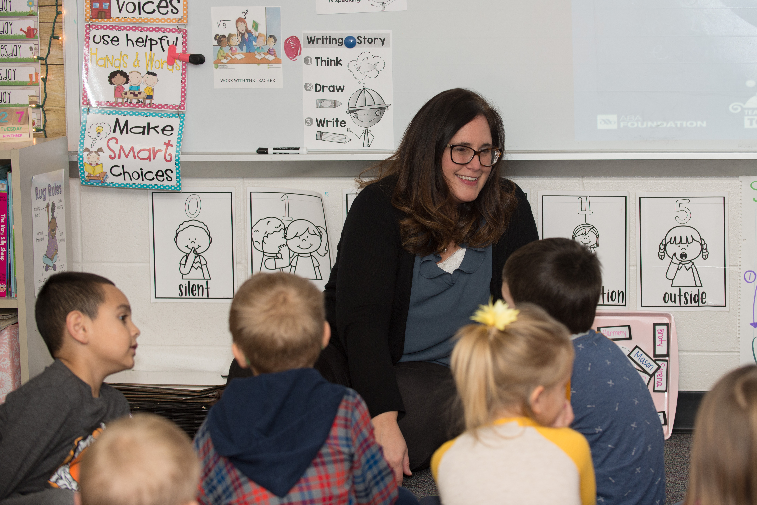
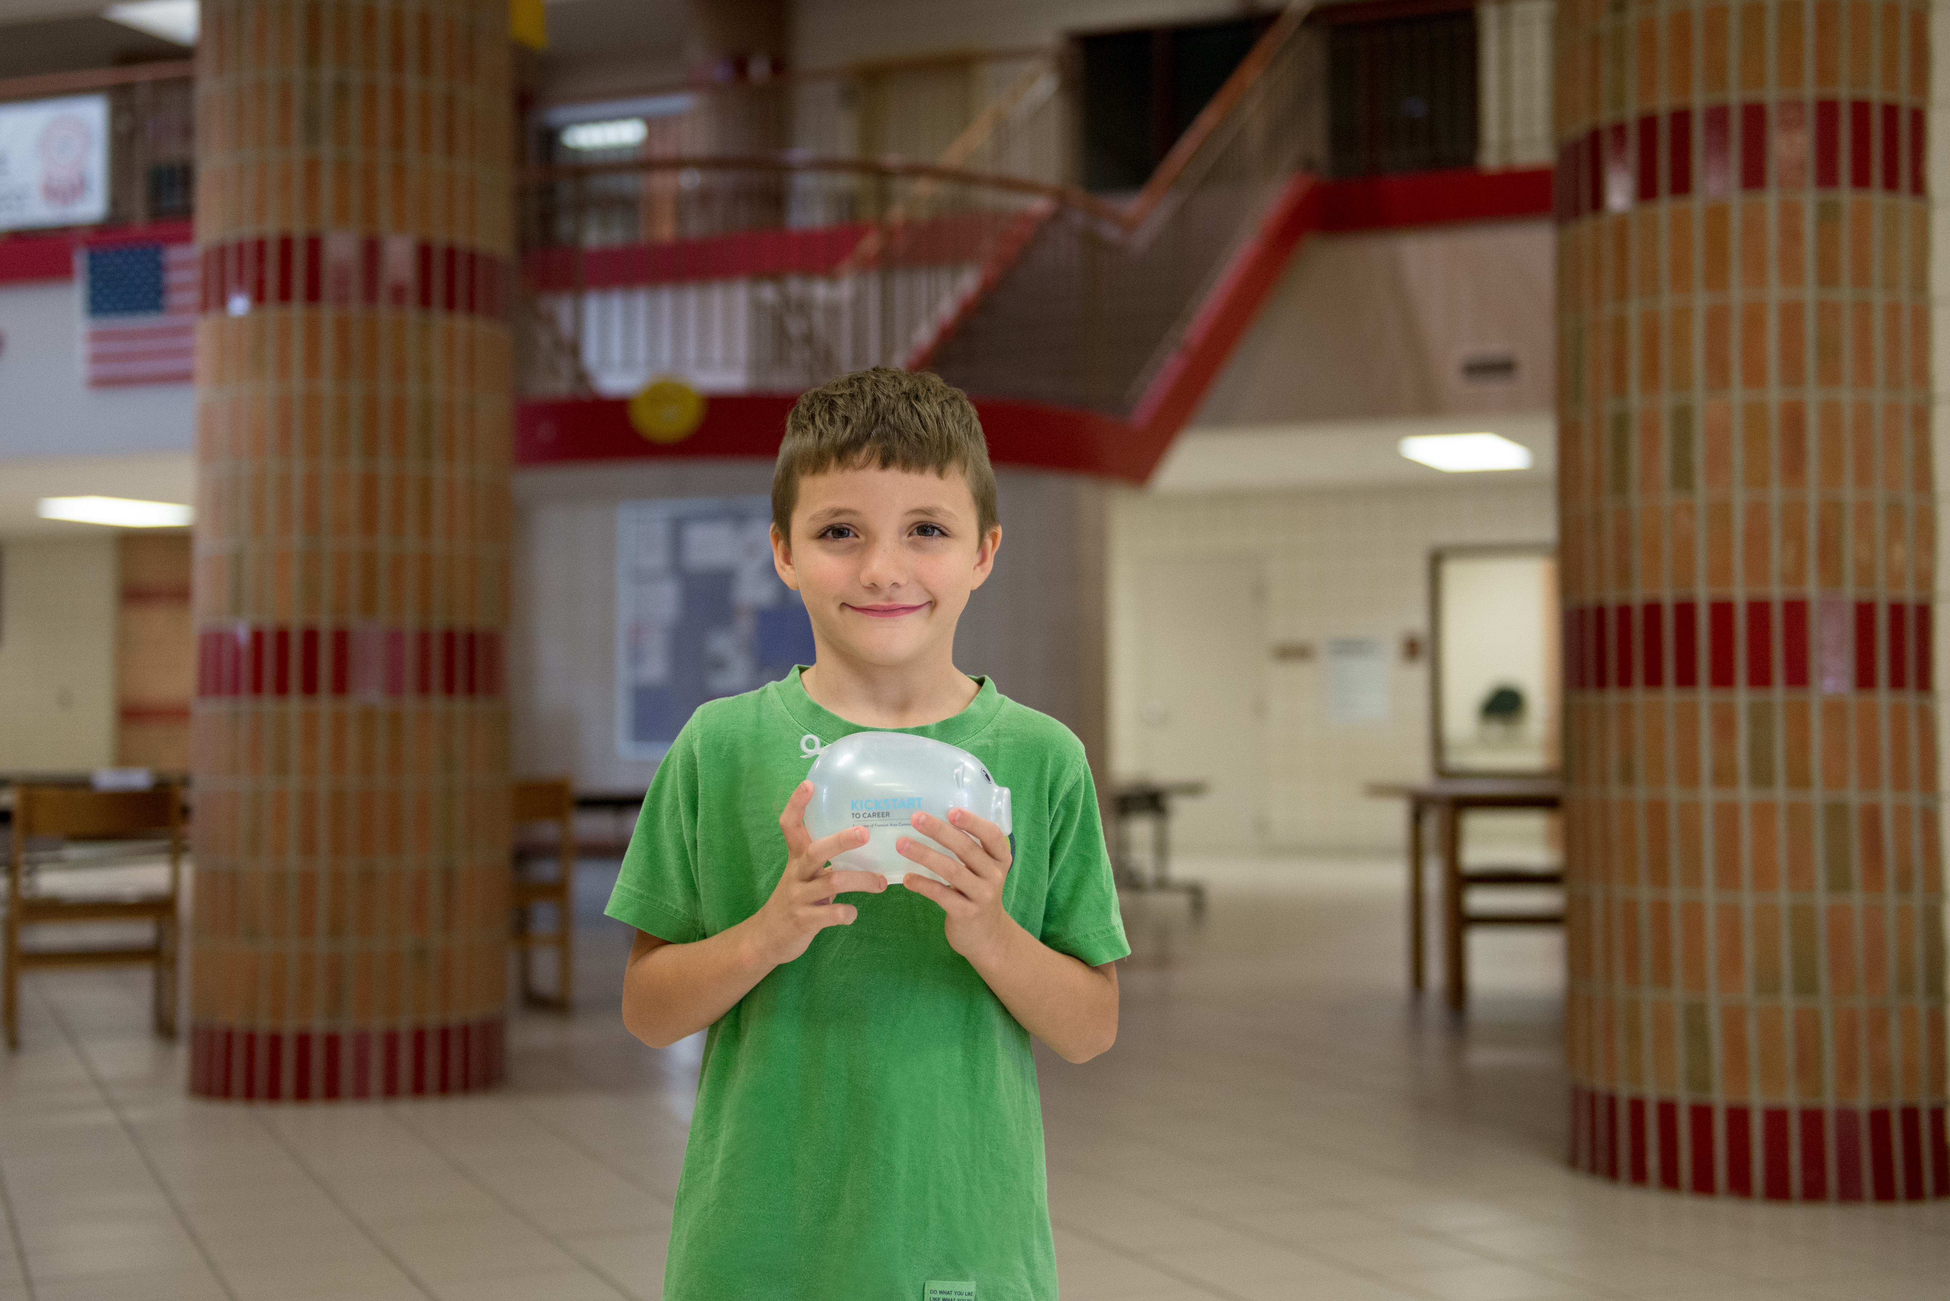
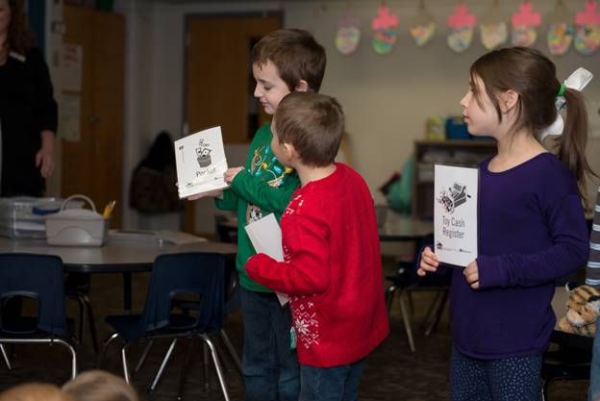
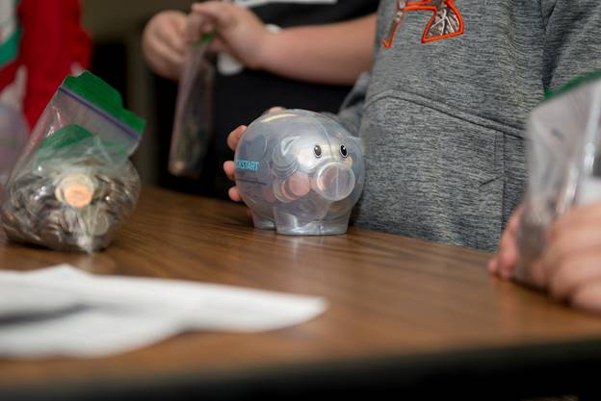
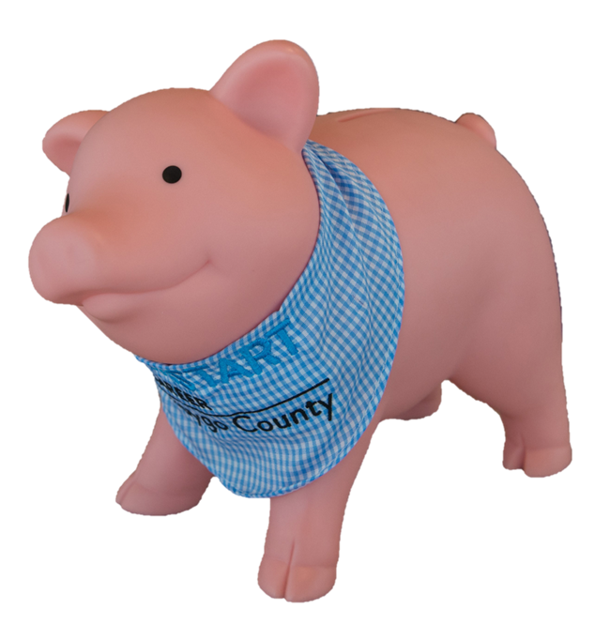
Notes:
(1) “Do you know what Kickstart to Career is?” (Raise your hand and those who know will follow suit). Encourage students to explain. Explain what the program is, and that each child has a Kickstart account.
“Does anyone remember Penny visiting you last year?” Have them raise hands.
“When Penny visited you last year, she taught 2nd graders what it means to earn money those who completed the workshop earned $50 in their Kickstart account! Today, Penny is going to help you learn what it means to budget.”
Pictures: FPS, FCS, WCPS, & GPS

Slide 3

Penny Says . . .
. . . raise your right hand
put it down!
. . . use that hand to make a piggy nose
. . . touch your toes
point to the sky!
. . . strut like a chicken
clap your hands!
. . . give someone a high five
Notes:
(9) Penny came up with an idea of using a game to learn today’s lesson. Who wants to play a game?
Play “Penny Says”, a version of “Simon Says”!
Start by having participants stand up and explain that if they do something that Penny didn’t “say”, they will sit back down. The game may end with a number of winners, not just one or two.

Slide 4

Penny Says . . .
Notes:
(3) Congratulate winners and all participants.
Can anyone tell me what the GOAL of that game may have been?
Who else wanted to reach that goal? Use hand raising.
What did you do to try to win? Take a couple of responses from students.
So, when we have something we really want; whether it is to earn or accomplish something, we can set a goal for ourselves. Who here has set a goal before? Use hand raising.

Slide 5


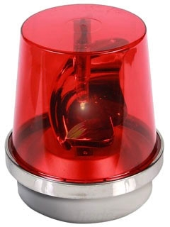
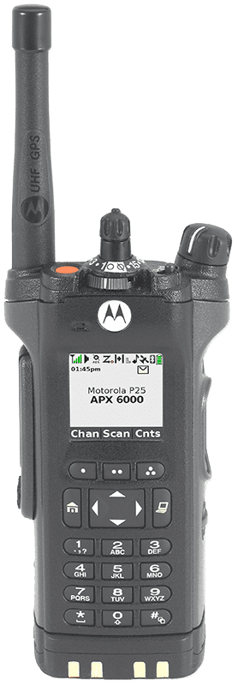
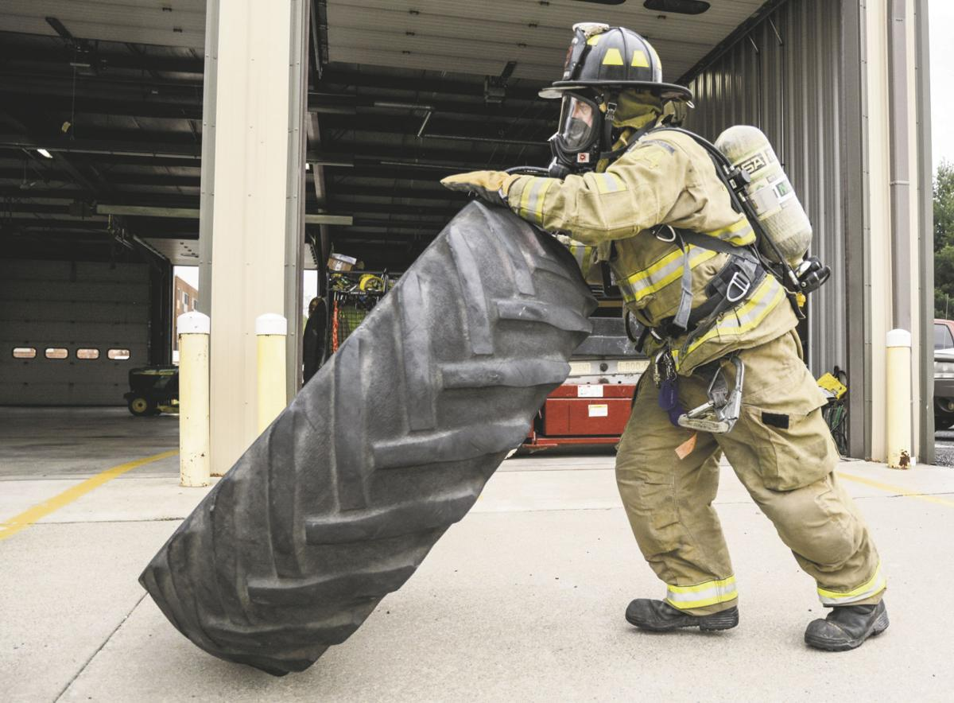
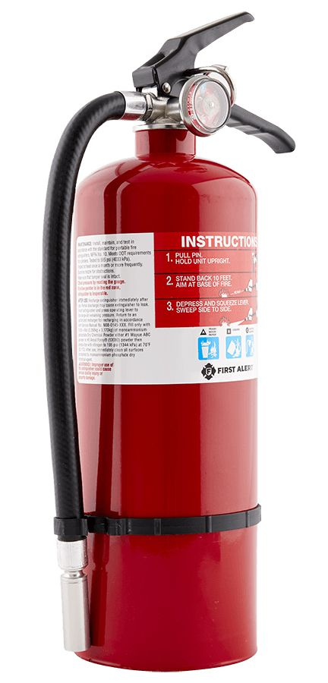
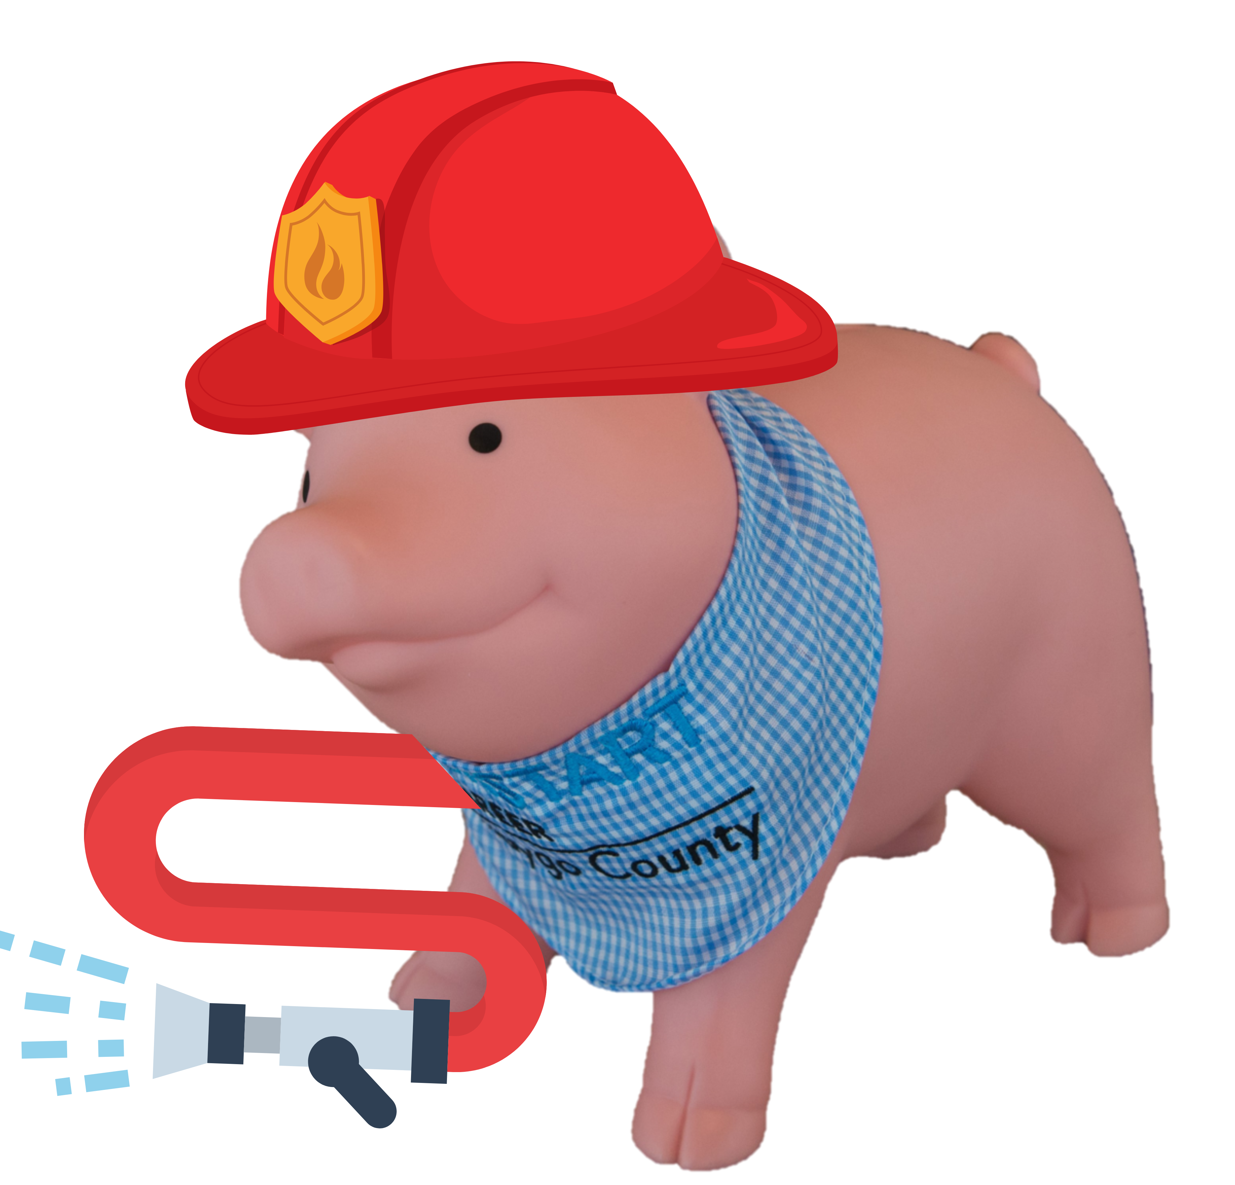
What equipment would Penny need to become a firefighter?
Notes:
Use cost cards for this slide
A savings goal is the amount of money you plan to save in order to buy or spend on something. “What are some things you’ve saved for? How did you save for them?”
“Today, we are going to help Penny create a budget. Does anyone know what a budget is?” A budget is a savings plan or record of money you earn and spend over a period of time.
“When Penny the Piggy Bank grows up, she plans to be a firefighter! What are some things Penny needs to be a firefighter?” Hold up cards as students guess them. (hat, siren, hose, fire extinguisher, training)
How much money do you think these items will cost? (total savings goal)
Hat: $500
Siren: $50
Hose: $300
Pager/radio: $100
Fire Extinguisher: $50
Training: $3,000
Total: $4,000

Slide 6
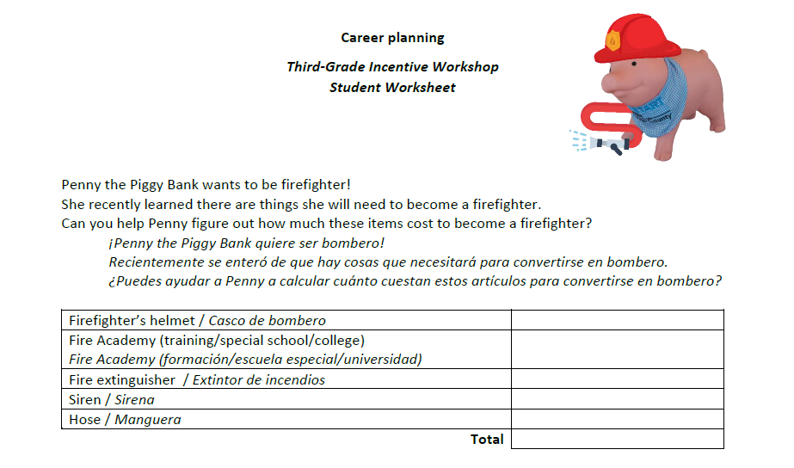
Worksheet directions
$ 550.00
$3,000.00
$ 50.00
$ 150.00
$ 250.00
$4,000.00
Notes:
(1)

Slide 7
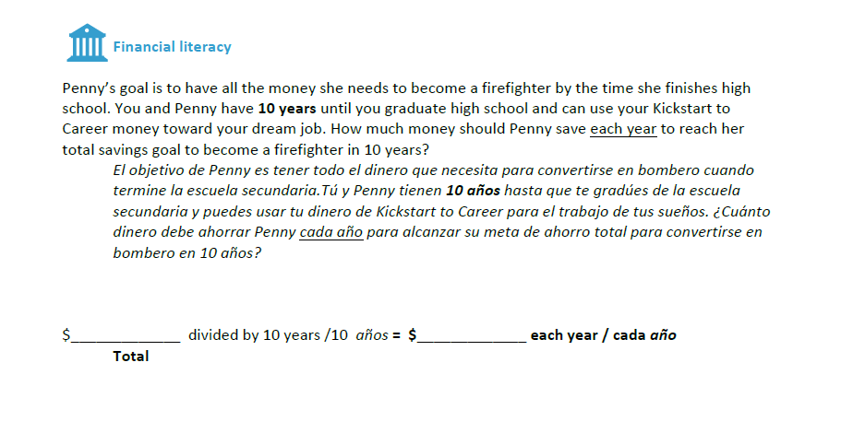
4,000.00
400.00

Slide 8
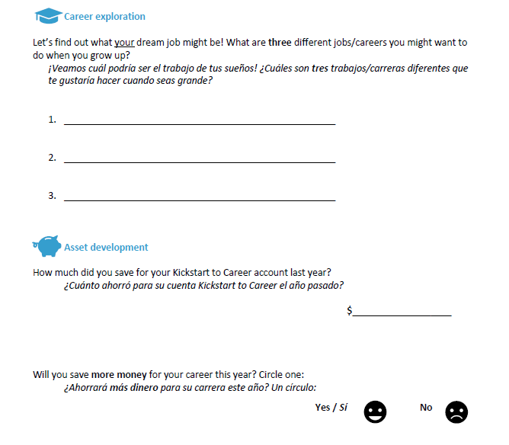

Slide 9



Notes:
(1) “Remember, you also have a Kickstart to Career account you can save your earned money in.”
Your teacher or parent is going to give you a worksheet to complete based on what we learned today.
You will start out by drawing a picture of a way you would earn money. Then you will be asked how much you think you could earn this year and how much of that money you could put in your Kickstart account to save for your future career. Finally, you will think about an adult in your life and share how that adult makes money.
After you are done completing the worksheet, your teacher or parent will collect the worksheet and hand you your certificate. $50 will be put in your Kickstart account for the hard work you did today learning about saving and spending. Thank you for letting Penny the piggy visit you virtually today! We hope to see you soon.

