Slide 1
Incentive workshop
Notes:
“Hello. My name is Mr./Ms./Mrs. ____.” You may use your fist name. Keep in mind that students are used to addressing adults in school as Mr., Ms., or Mrs.
Introduce the mascot “I am here today with Kickstart to Career Newaygo County. I have brought my friend, Penny the Piggy Bank.” (Show Penny to the students, welcome them to greet her.)

Slide 2
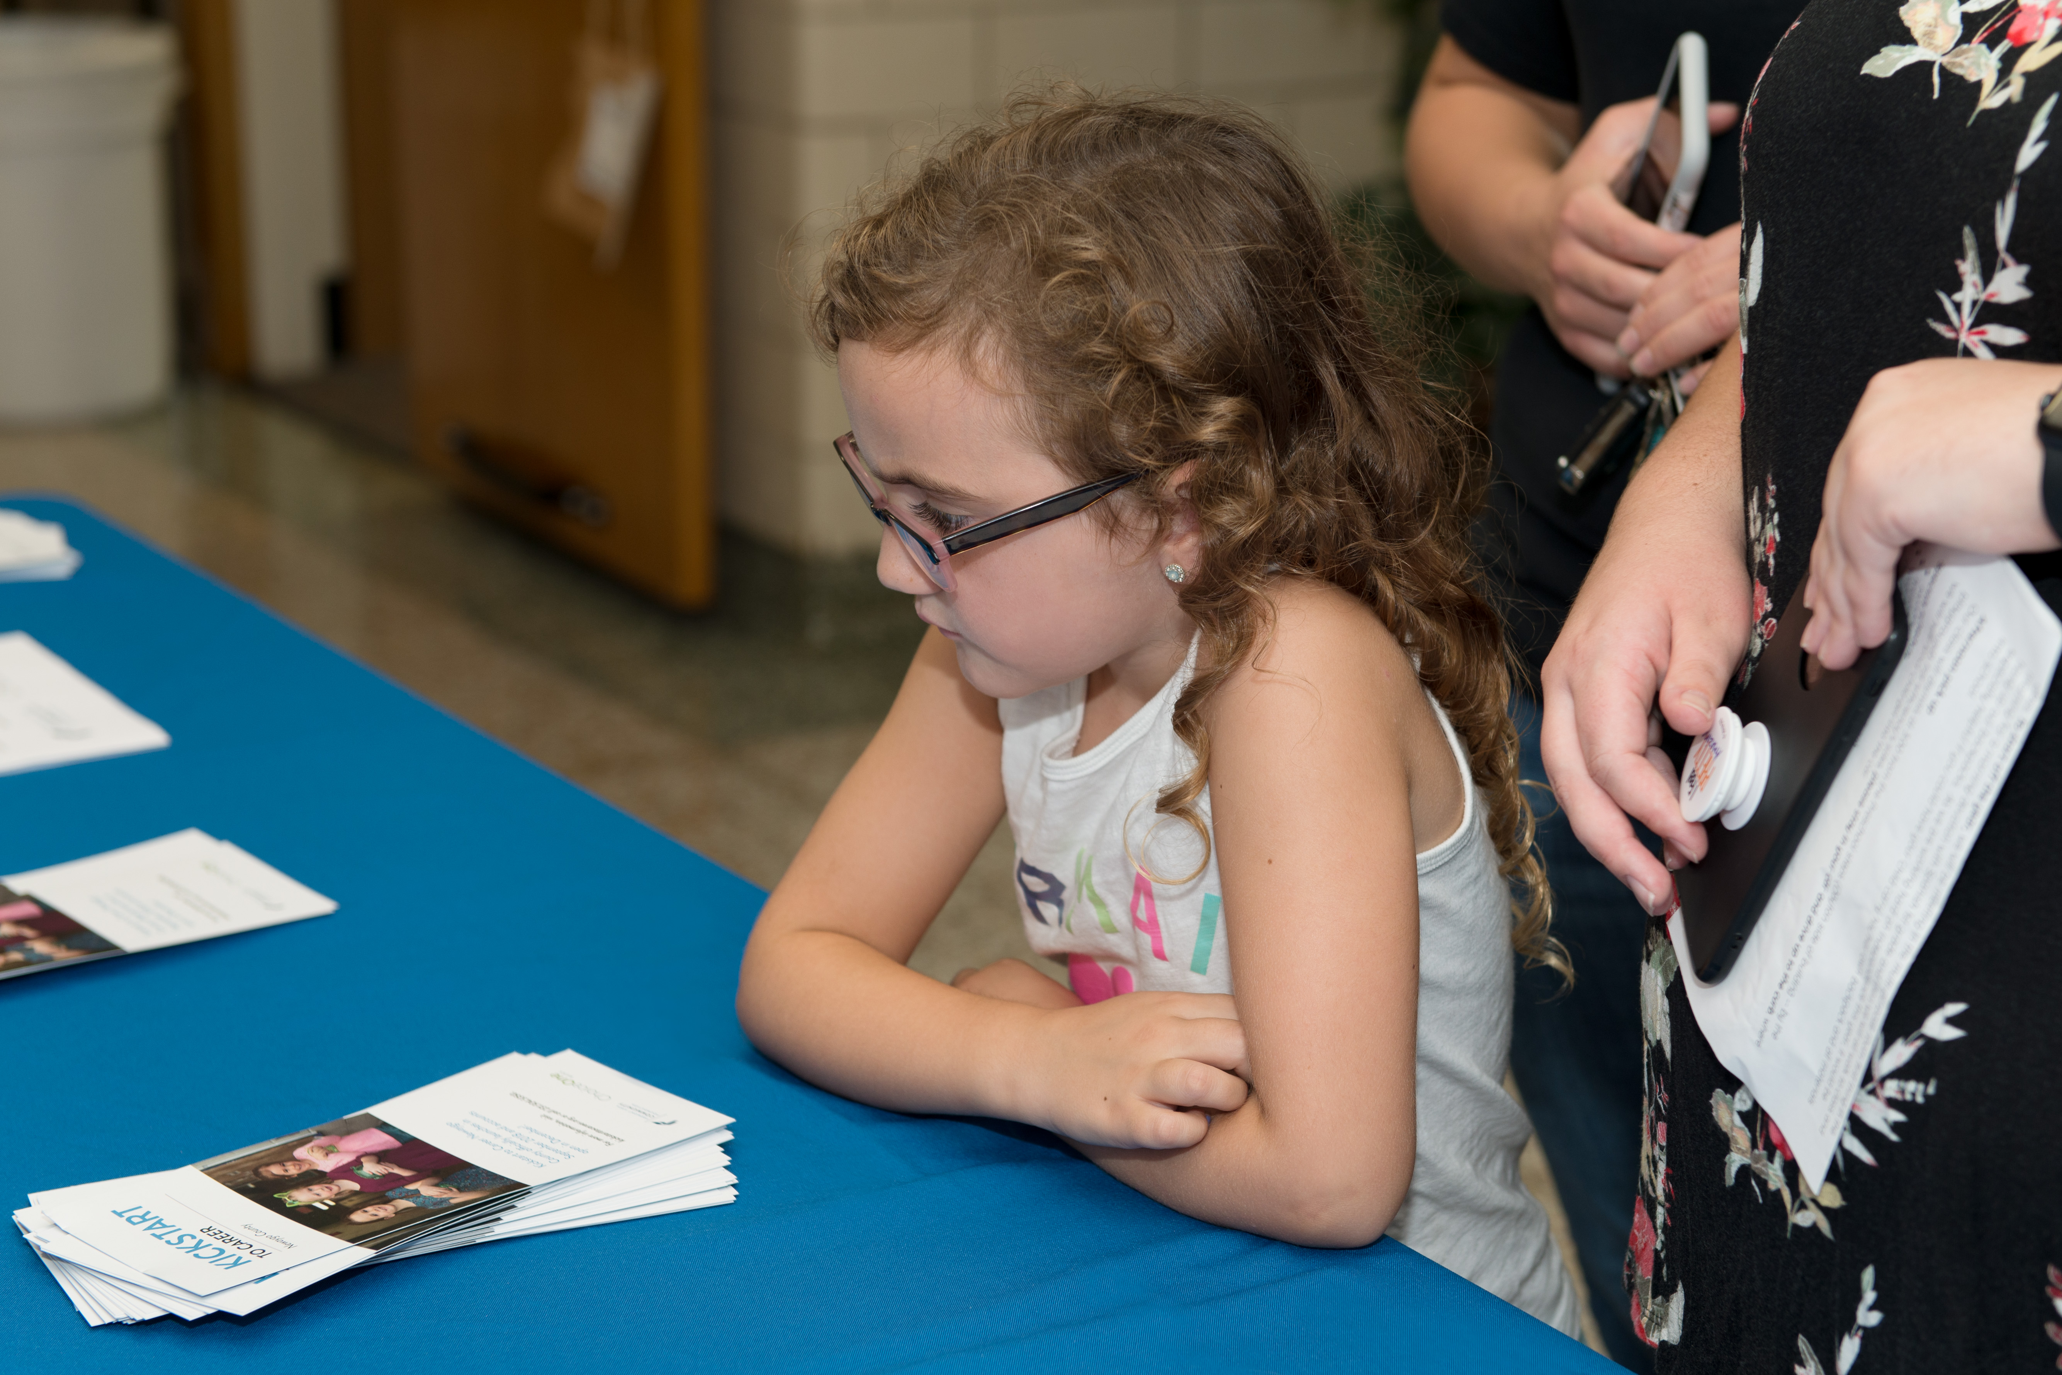
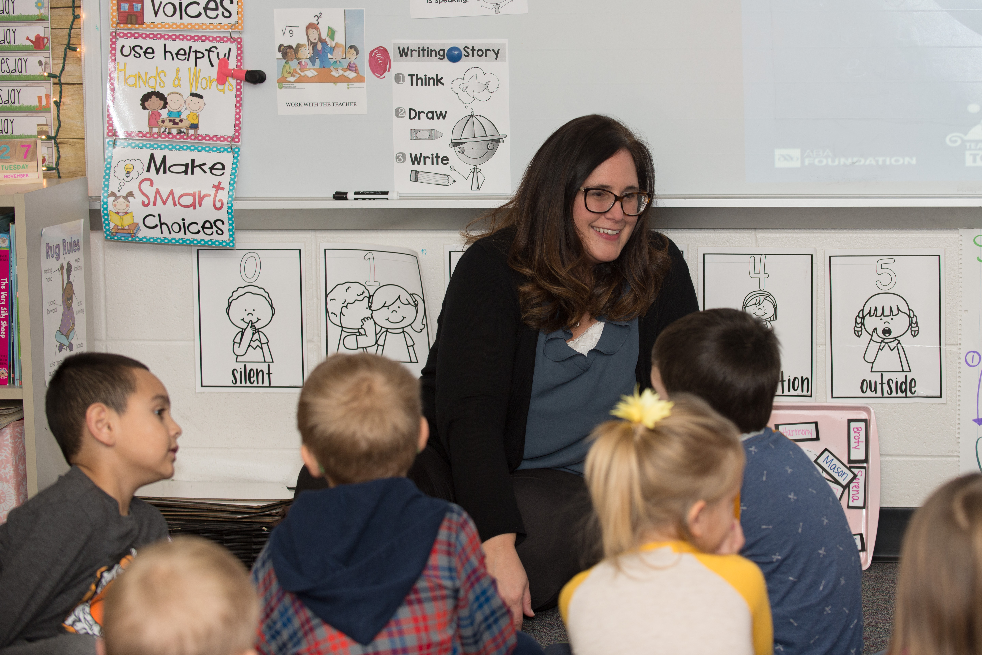
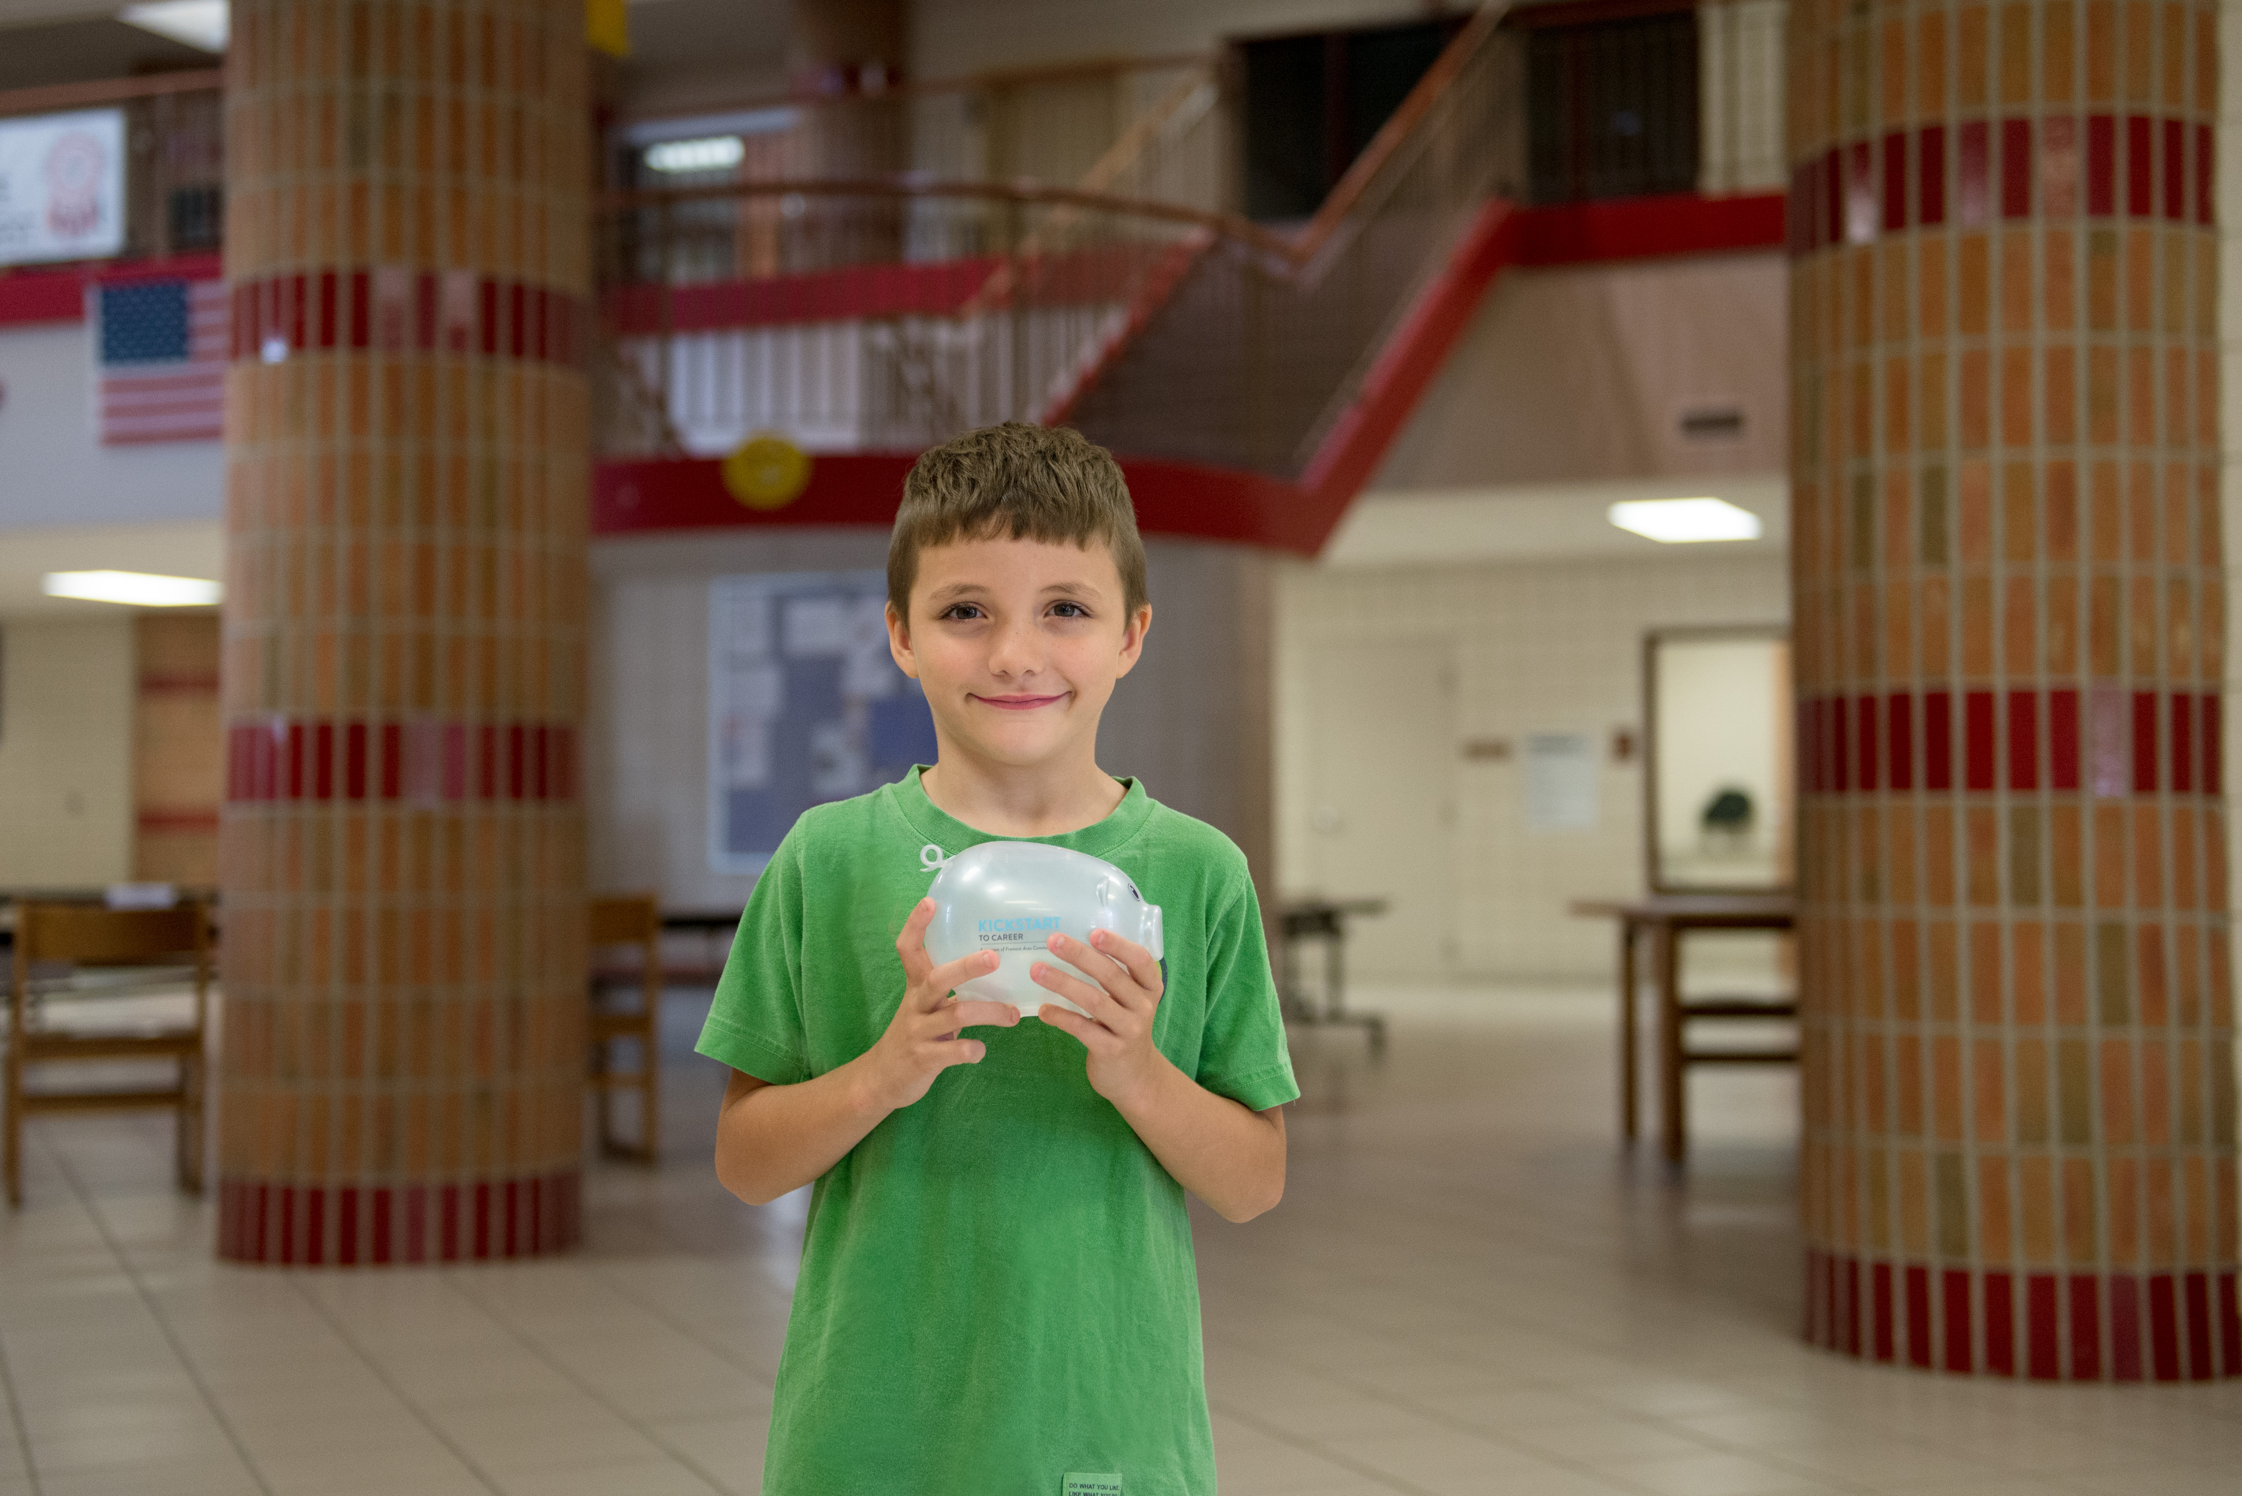
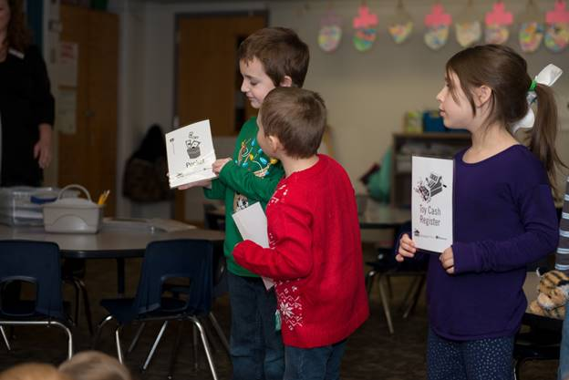
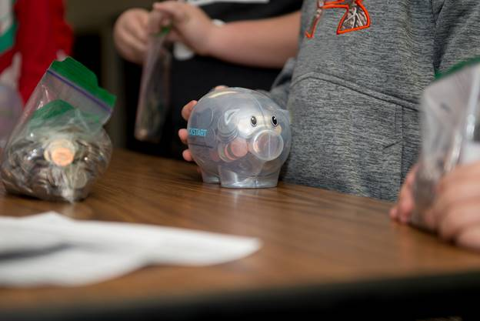
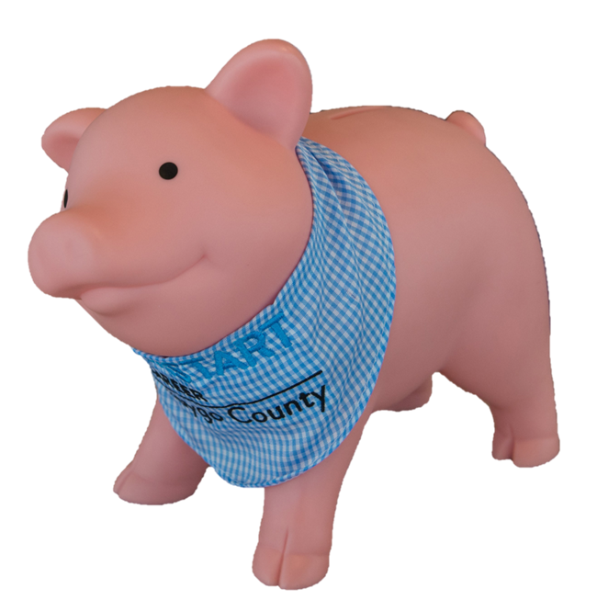
Savings account program
Notes:
*Note: intentional pause for raising hands & responses
“Do you know what Kickstart to Career is?” (Raise your hand and those who know will follow suit). Encourage students to explain. Explain what the program is, and that each child has a Kickstart account.
“Does anyone remember Penny visiting you last year?” Listen to responses.
“When Penny visited you last year, she recognized you as being a Kickstart Kid (displaying good behavior) and $50 was put in your Kickstart account! Today, Penny is going to help you learn what it means to earn money.”
Pictures: FPS, FCS, WCPS, & GPS

Slide 3
What ways do people make money?
Notes:
*Note: intentional pause for raising hands & responses
“Does anyone here know ways to make money? Take a minute to share with your teacher or parent” … If you didn’t get the chance to share, here are some ideas of ways to earn money (XXXXX)
Explain while some ideas are things they can when they are older, others can be done right now.

Slide 4
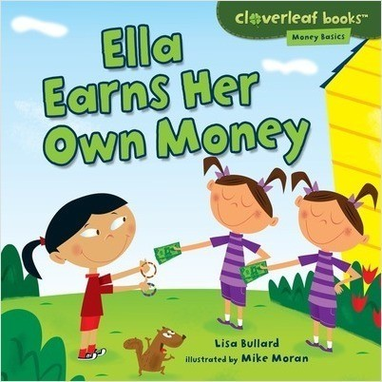
Ella Earns Her Own Money
Notes:
Today, I have a story about how a little girl who earns money to buy a soccer ball. Listen carefully because you will be asked a few questions at the end.
Read story book (Ella Earns Her Own Money by Lisa Bullard)

Slide 5
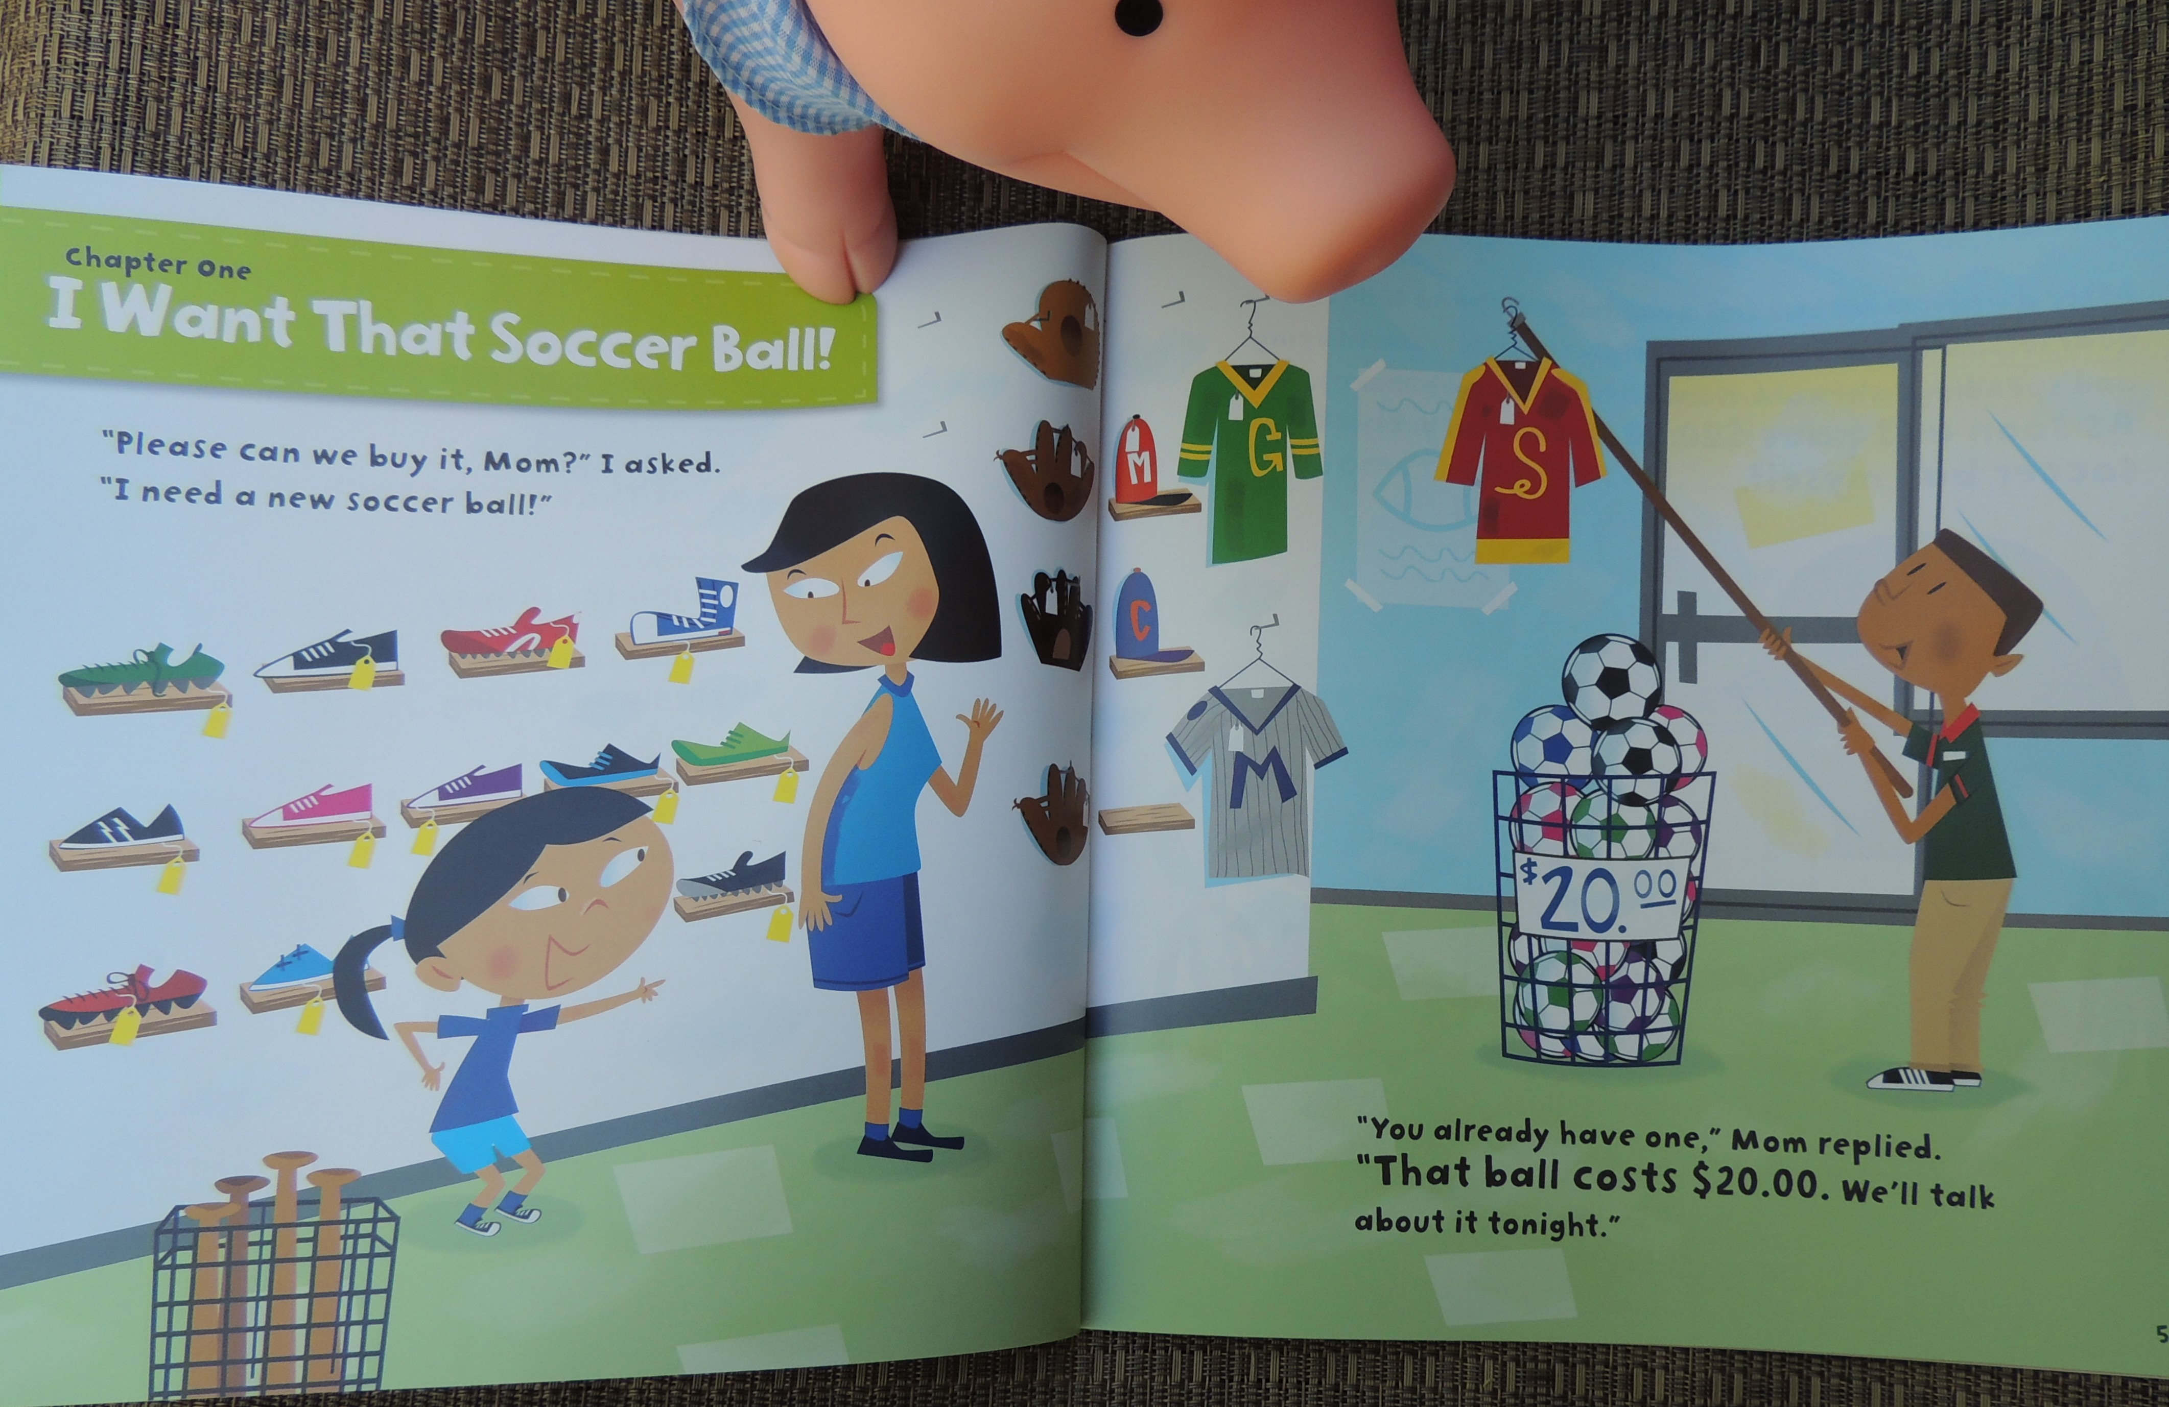
Notes:
Chapter one I want that soccer ball

Slide 6
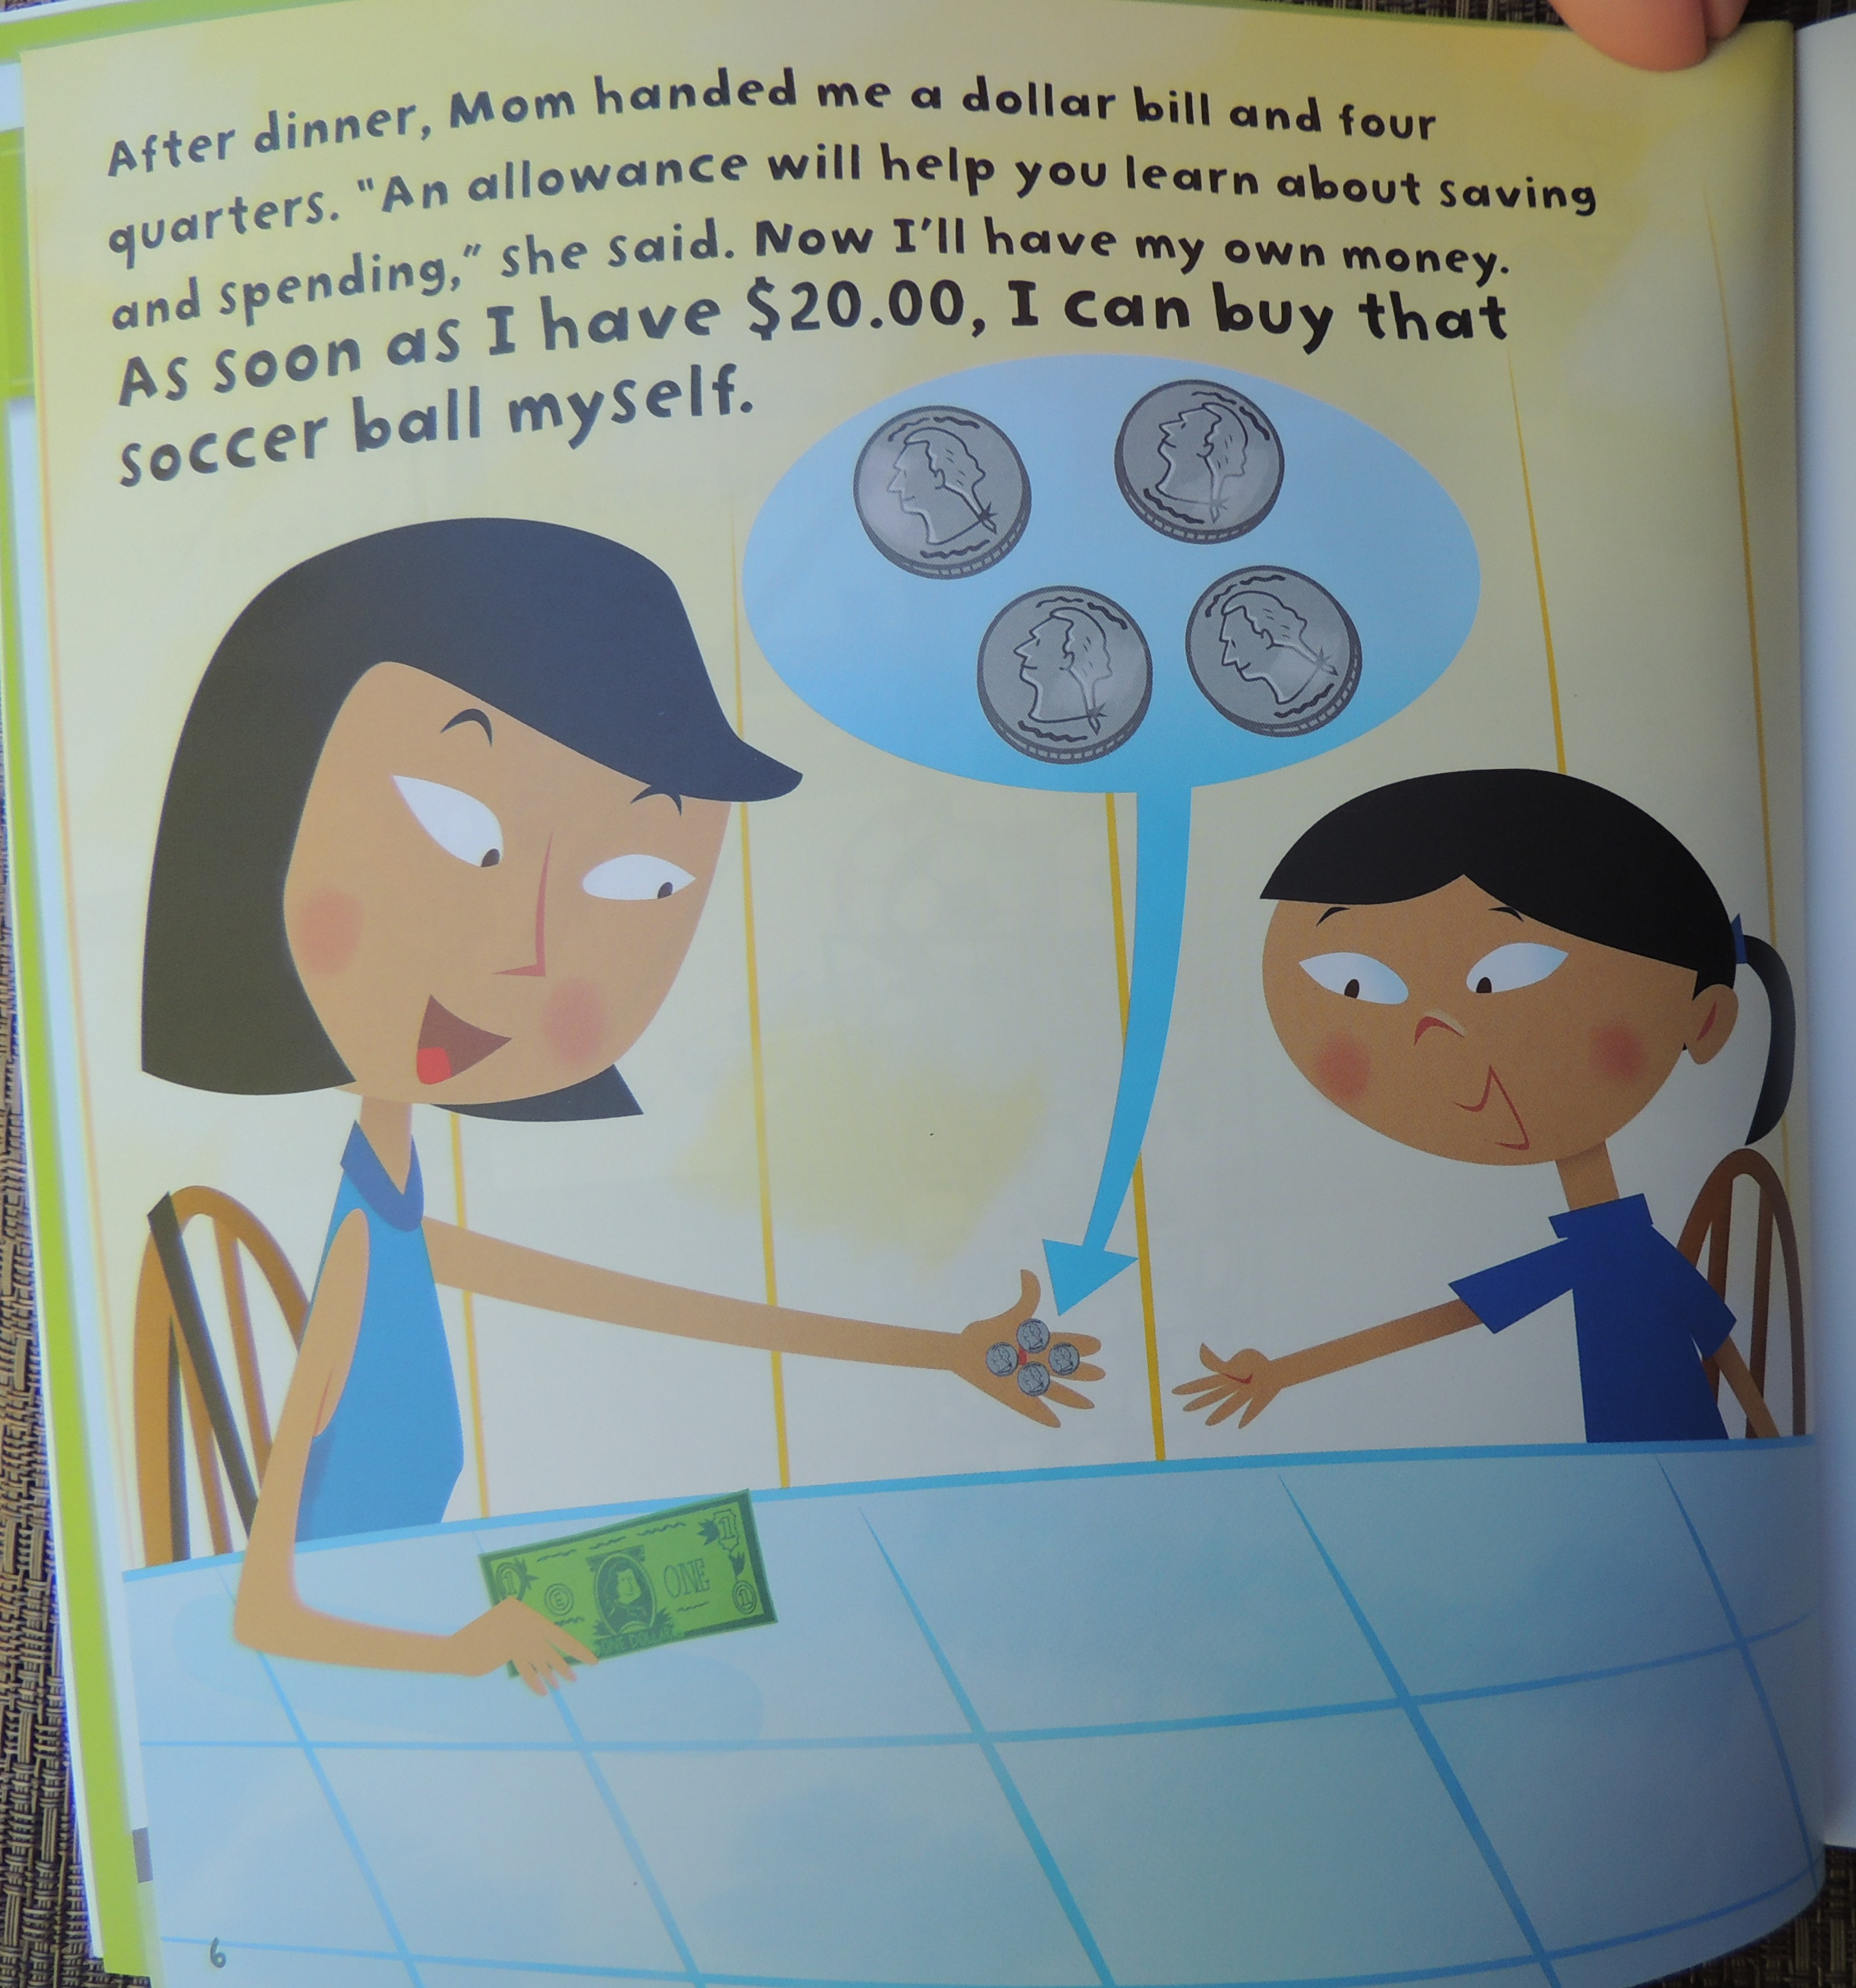

Slide 7
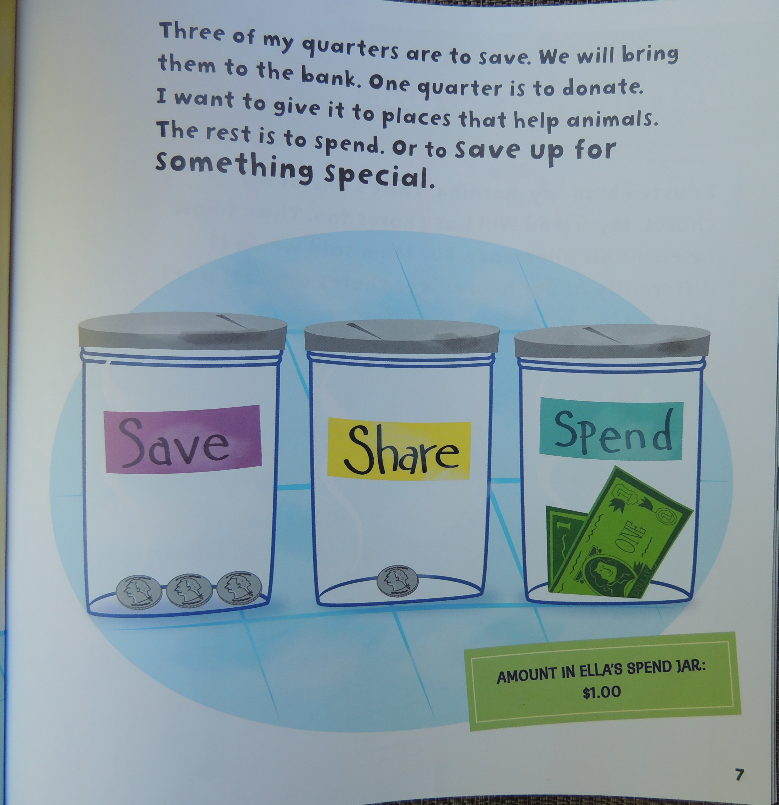
Three of my quarters

Slide 8
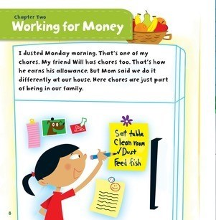

Slide 9
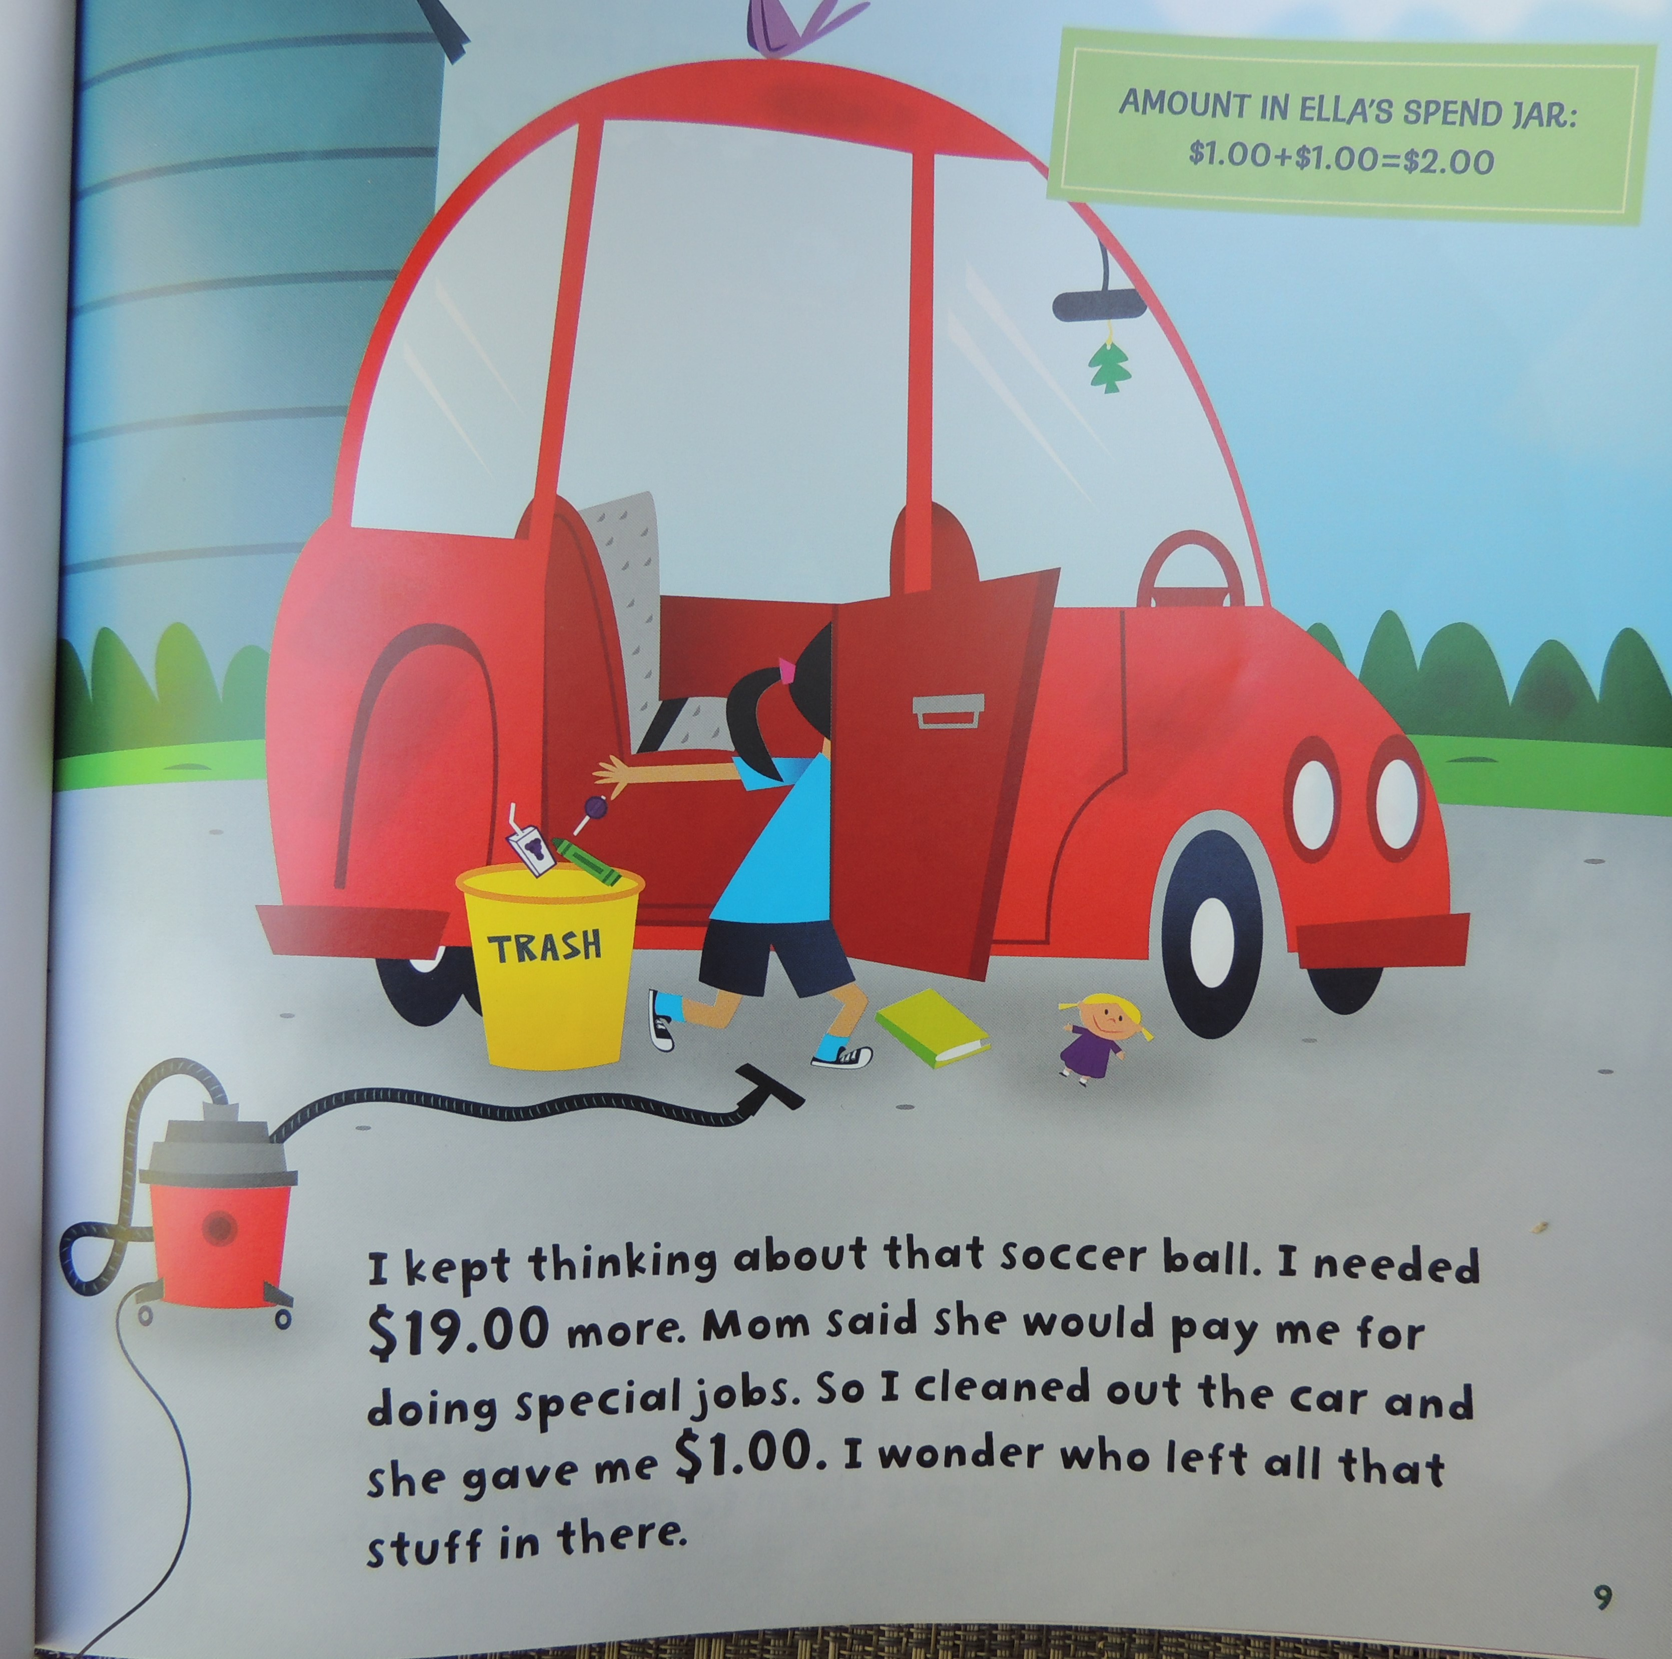

Slide 10
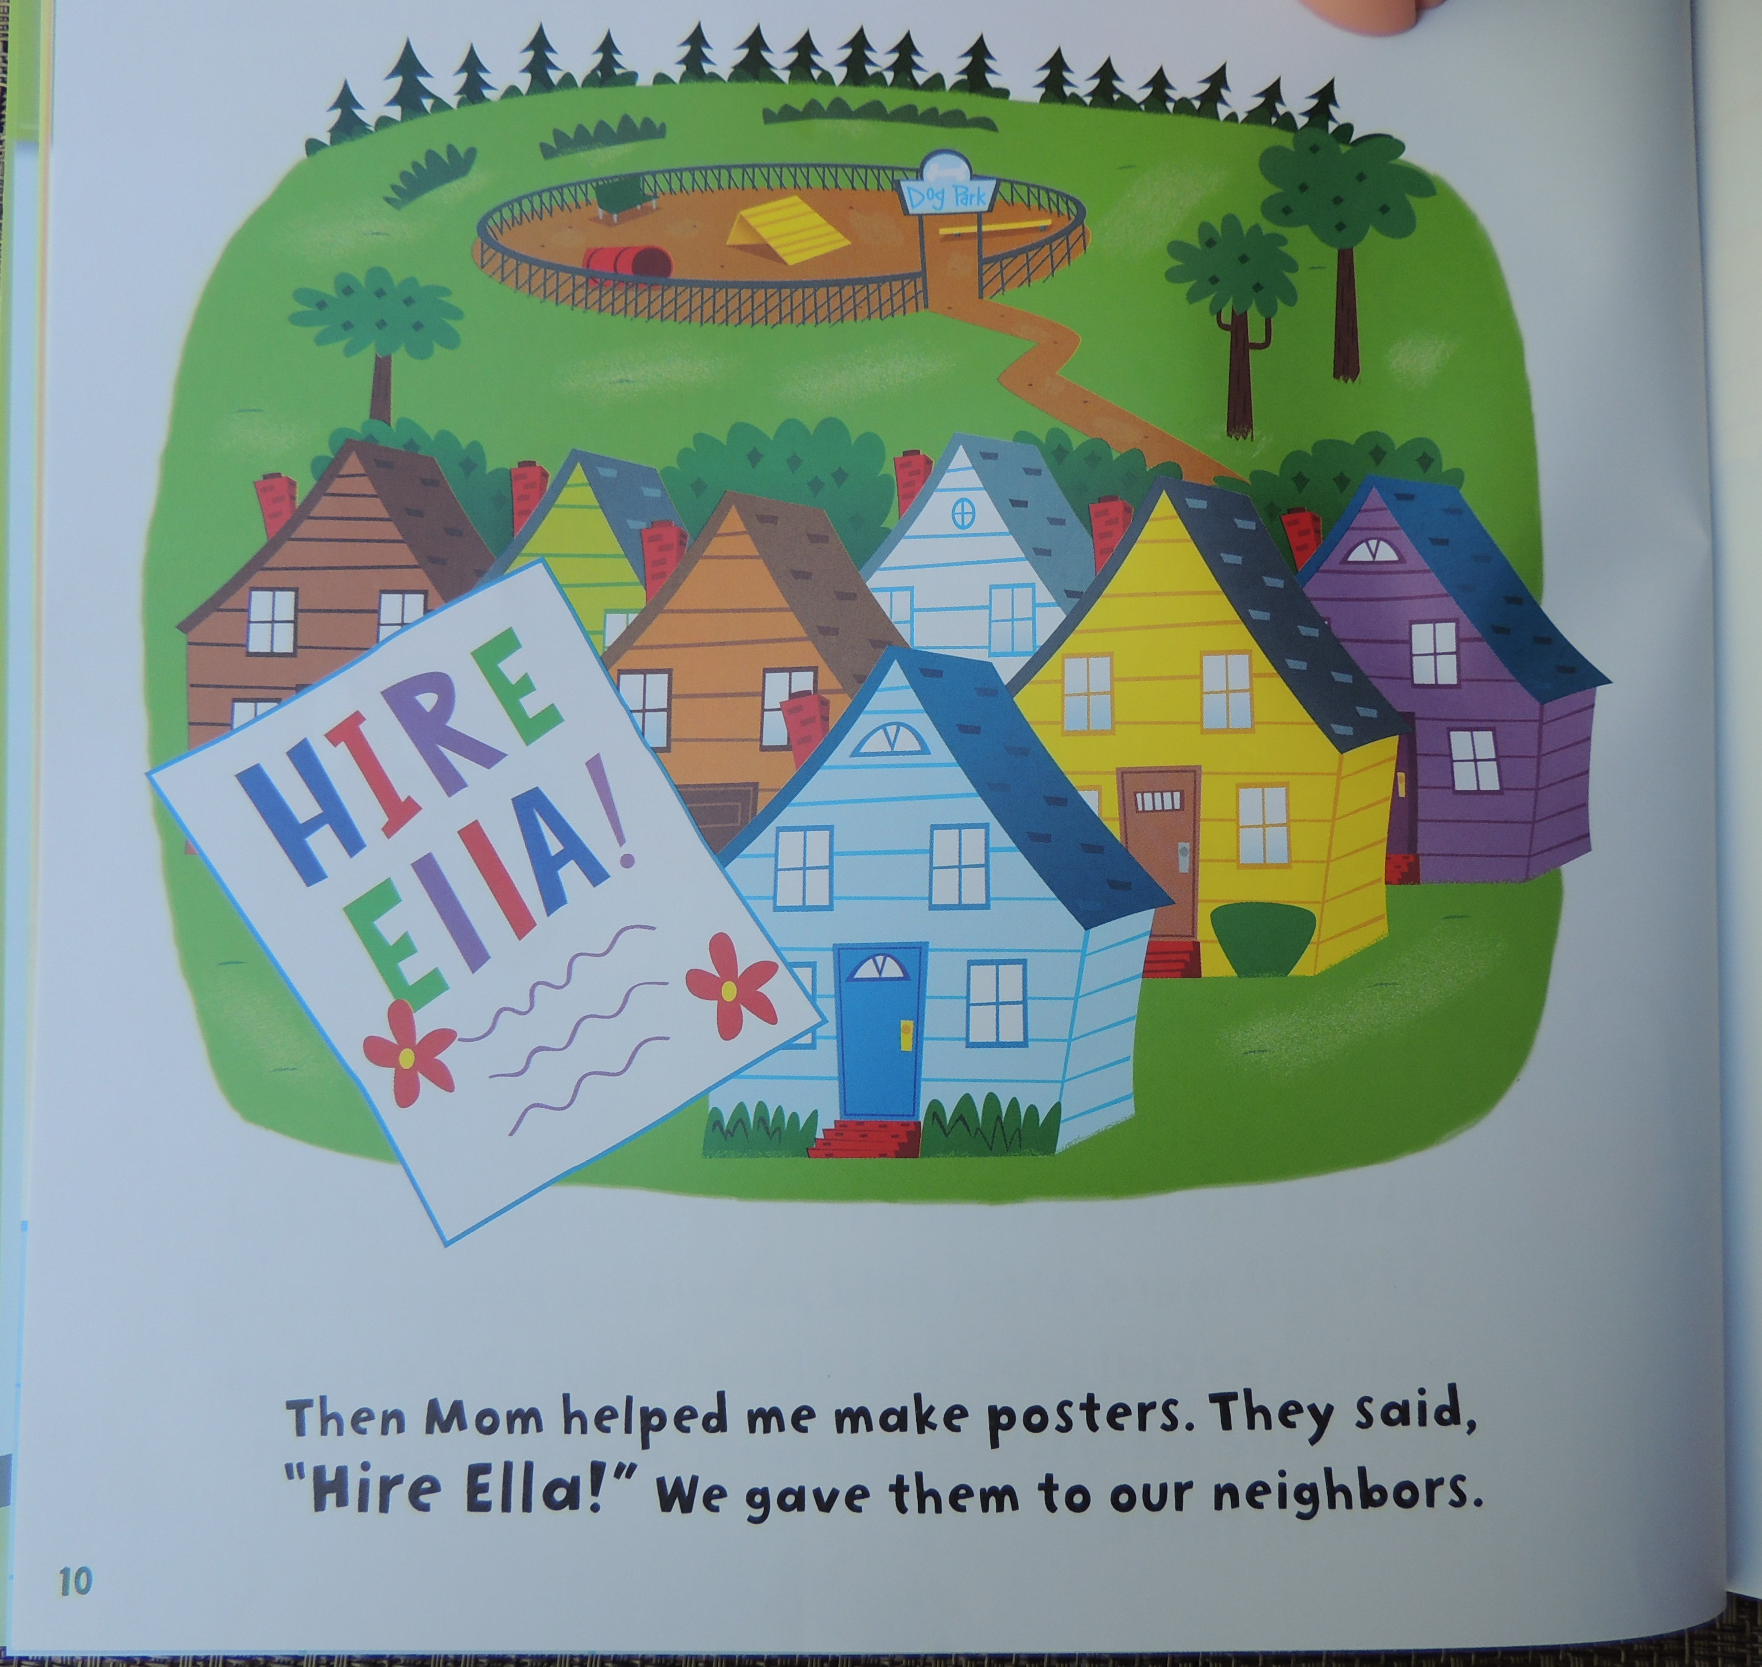

Slide 11
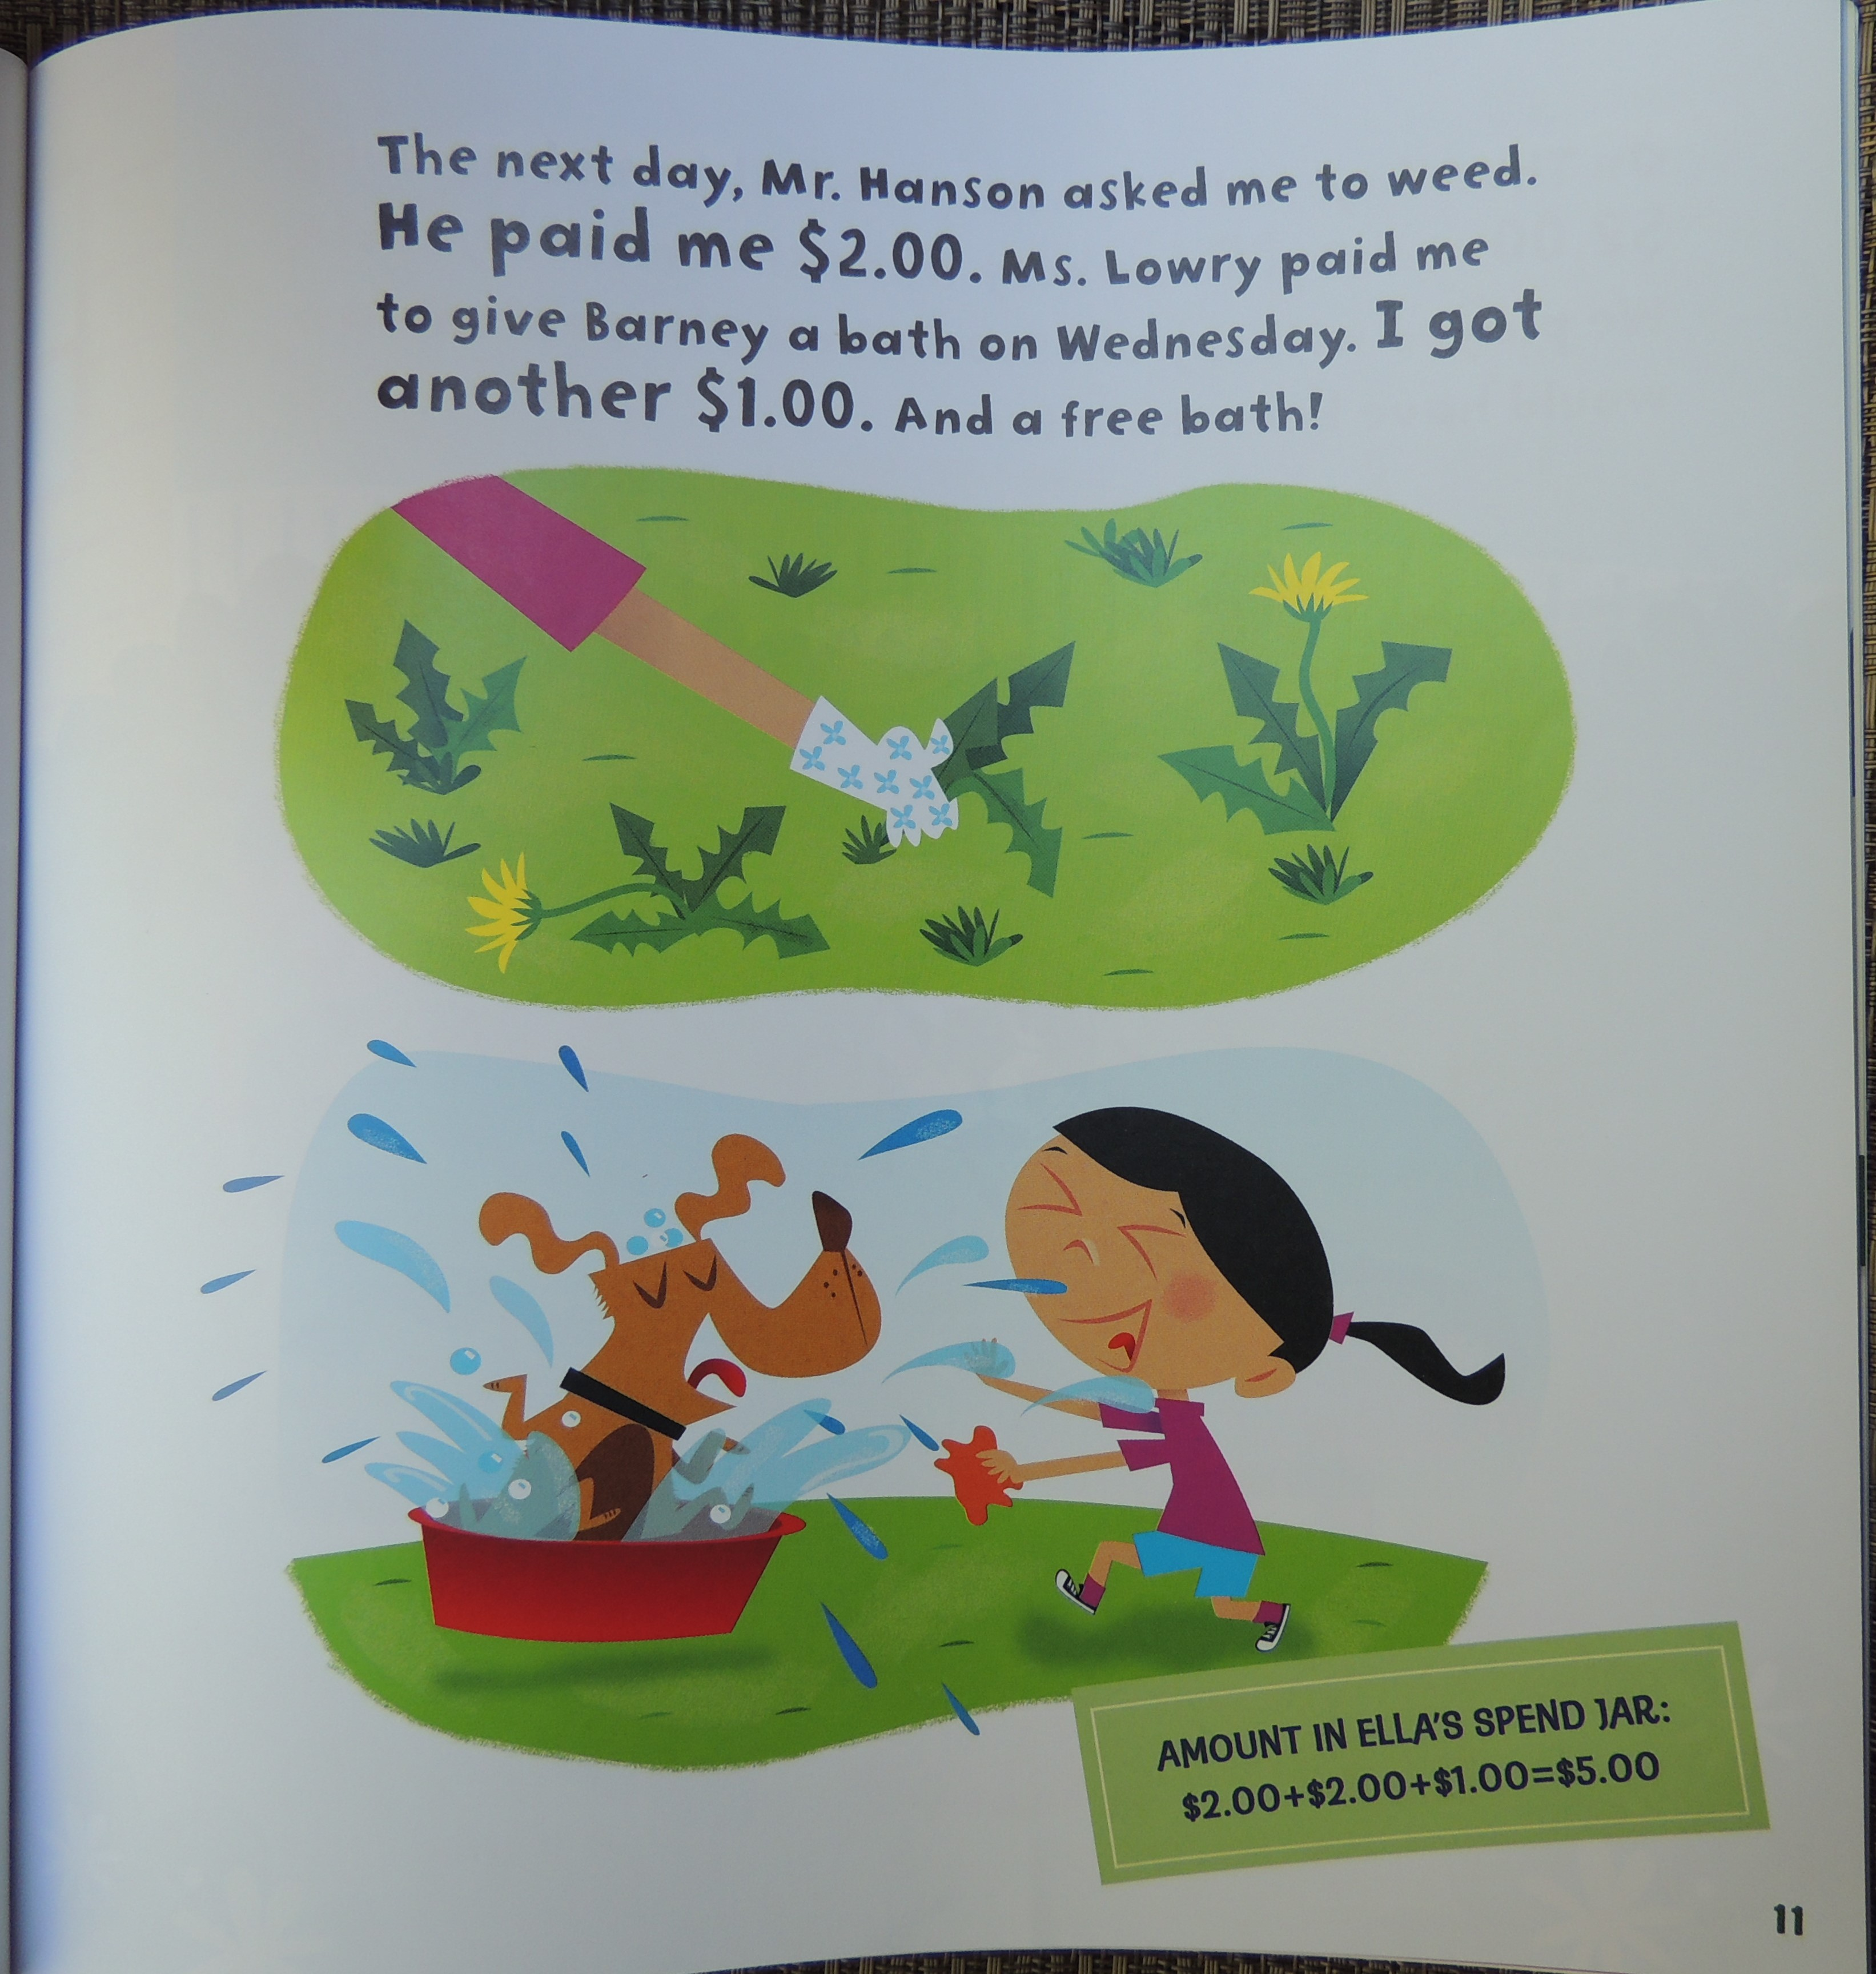

Slide 12
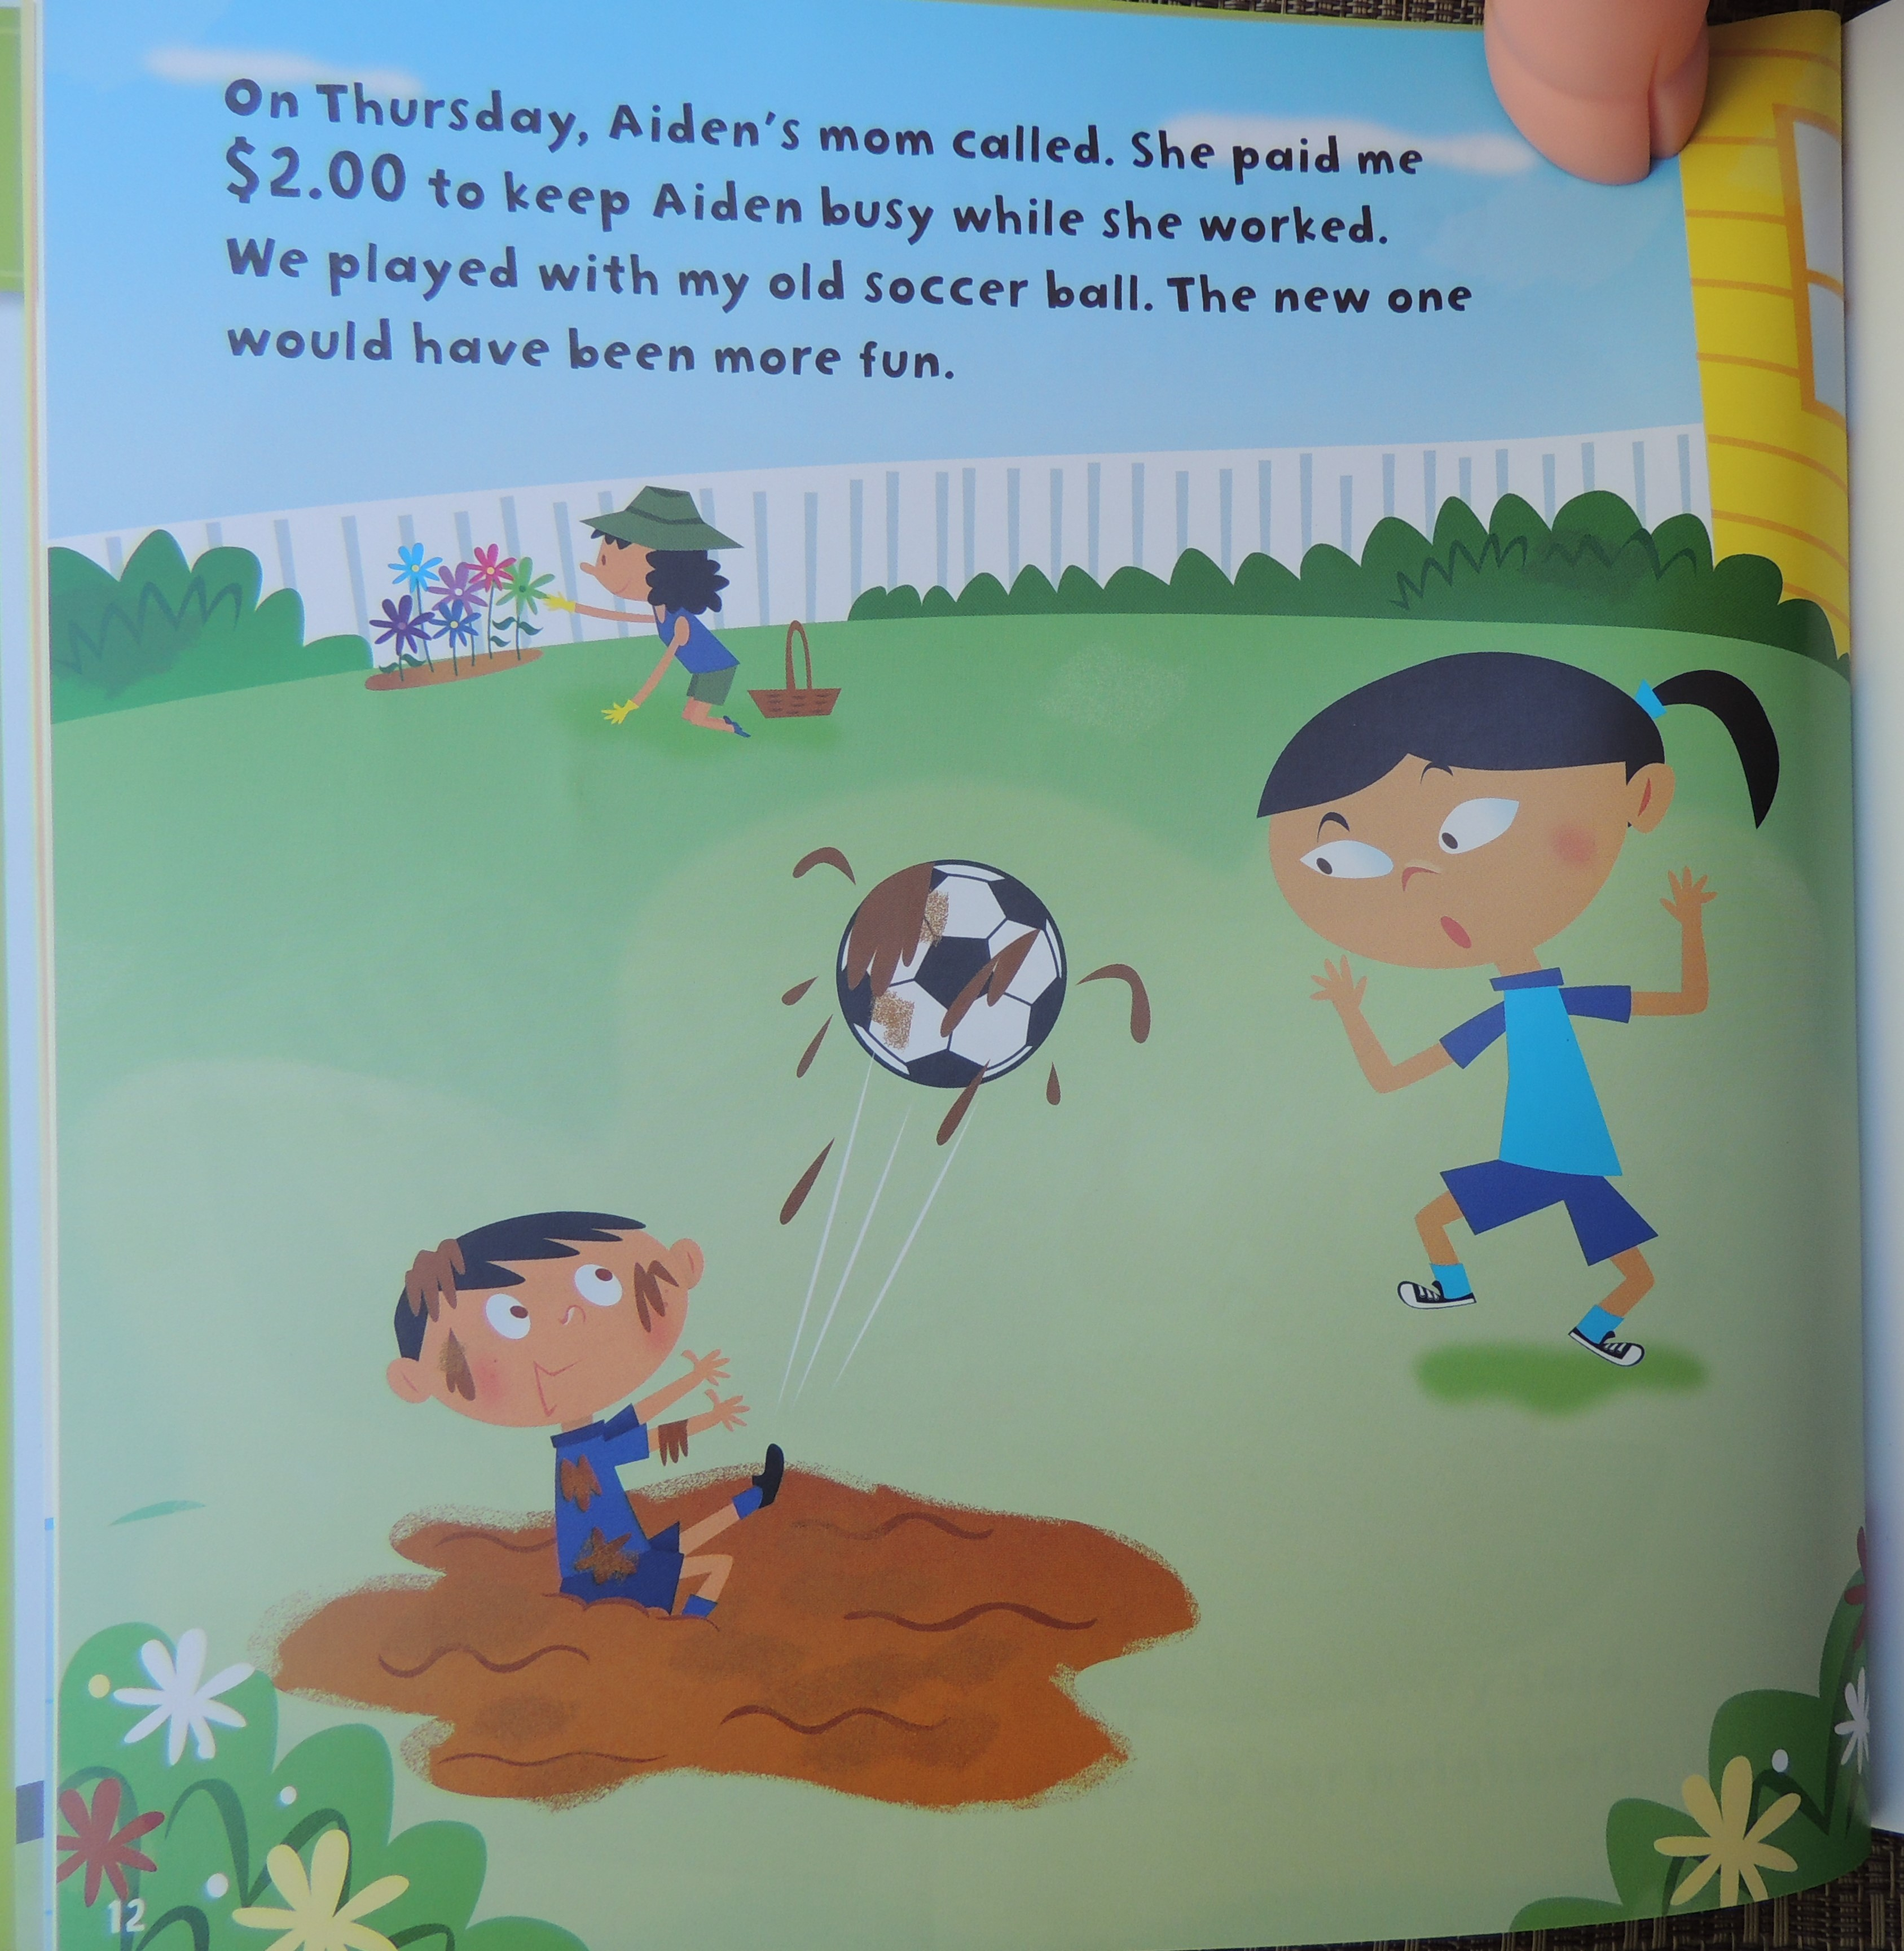

Slide 13
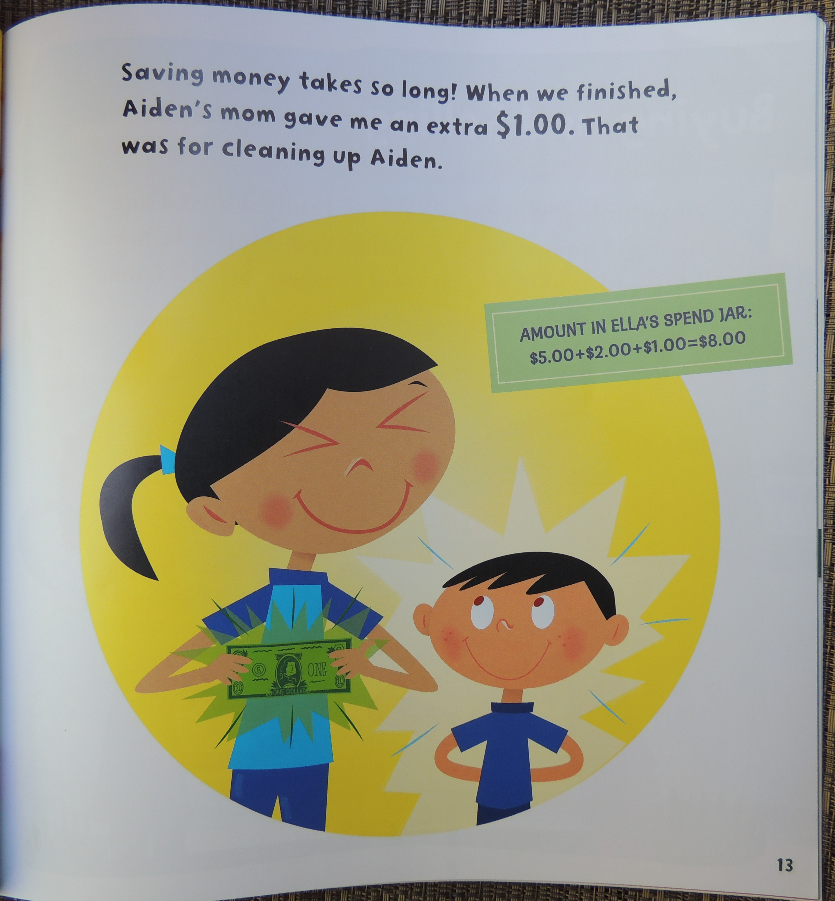

Slide 14
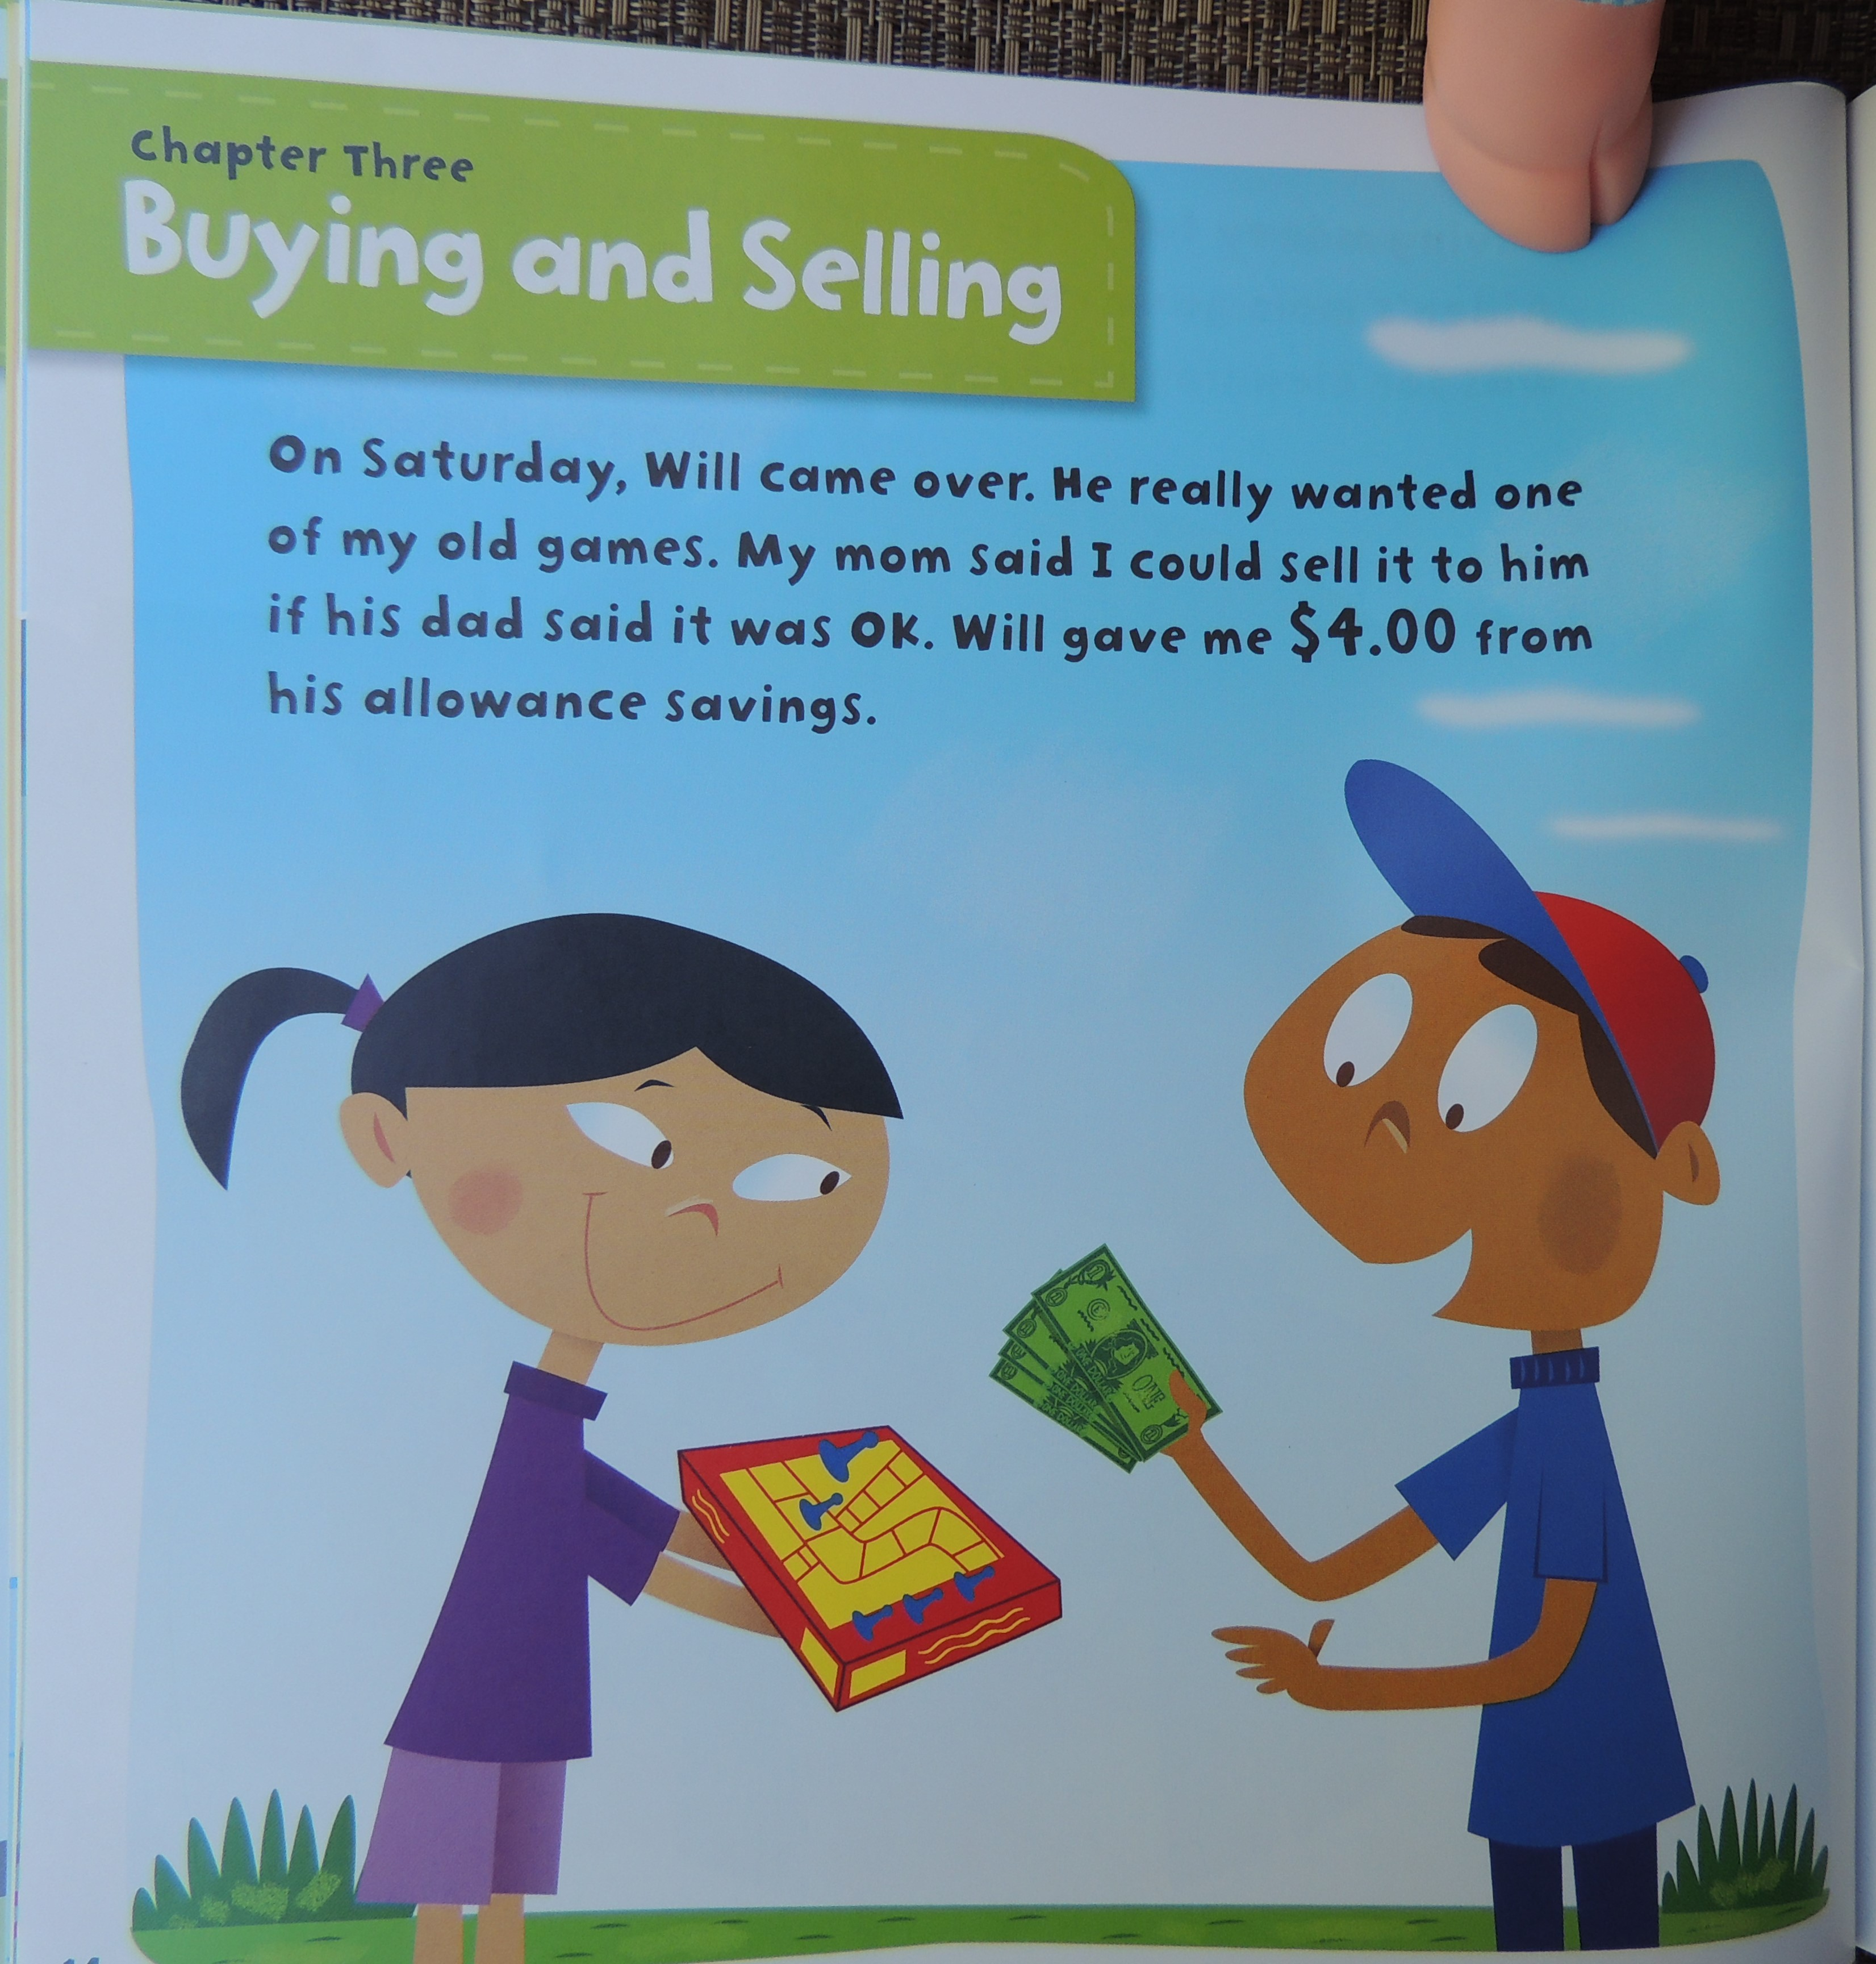

Slide 15
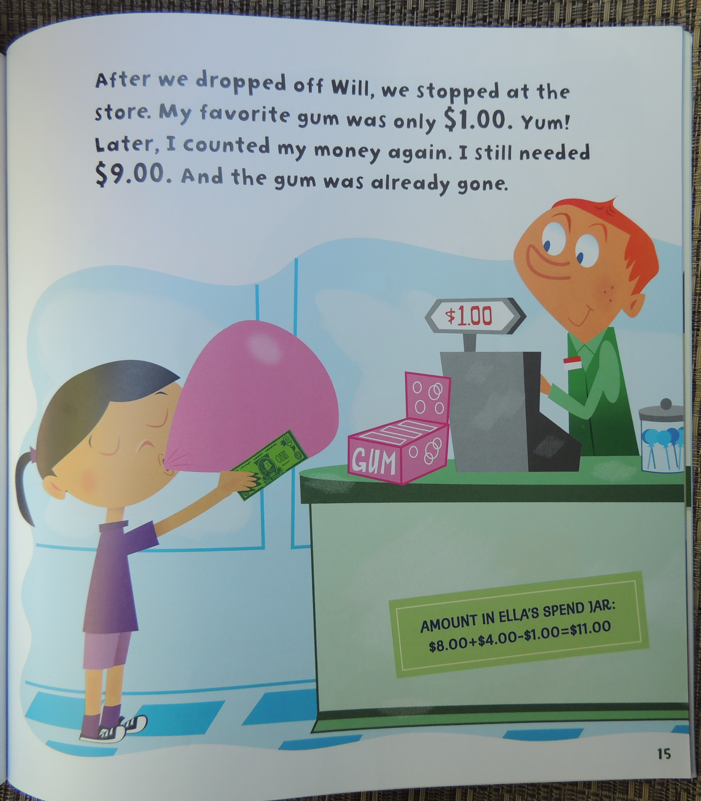

Slide 16
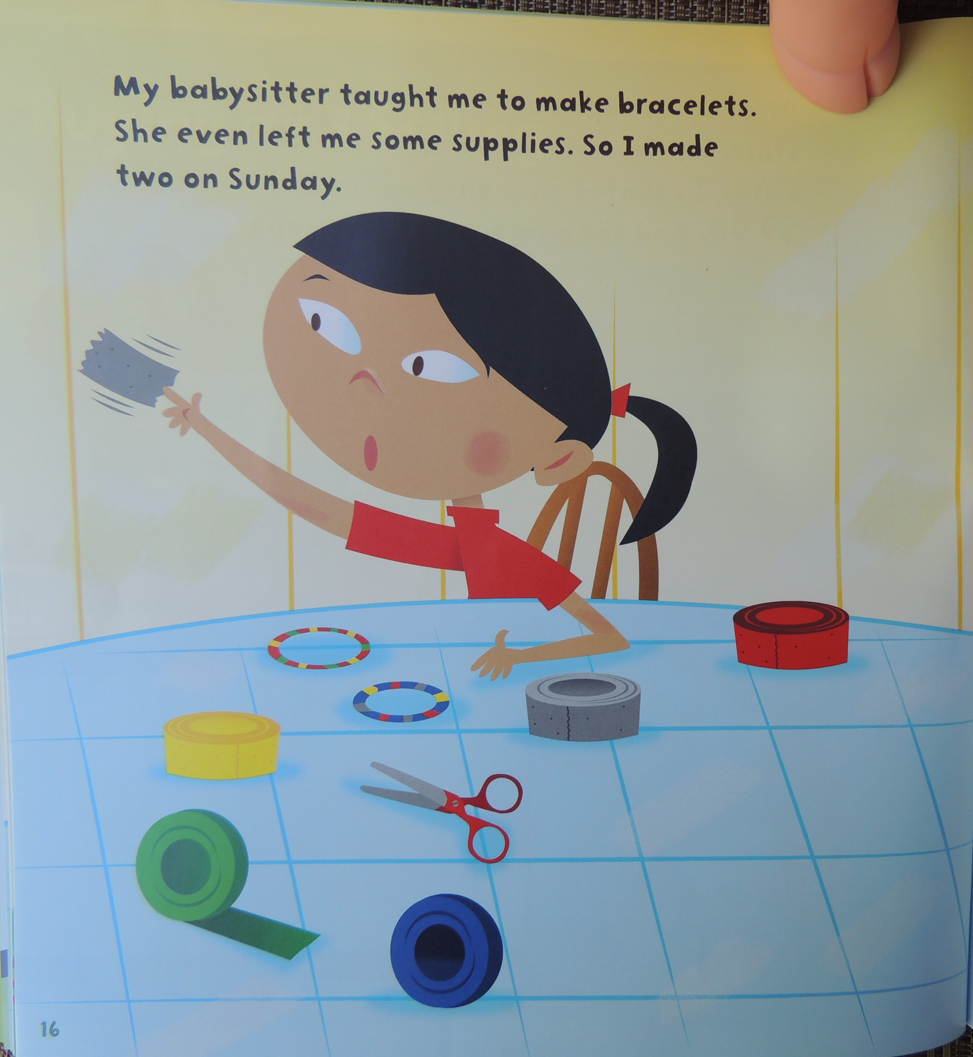

Slide 17
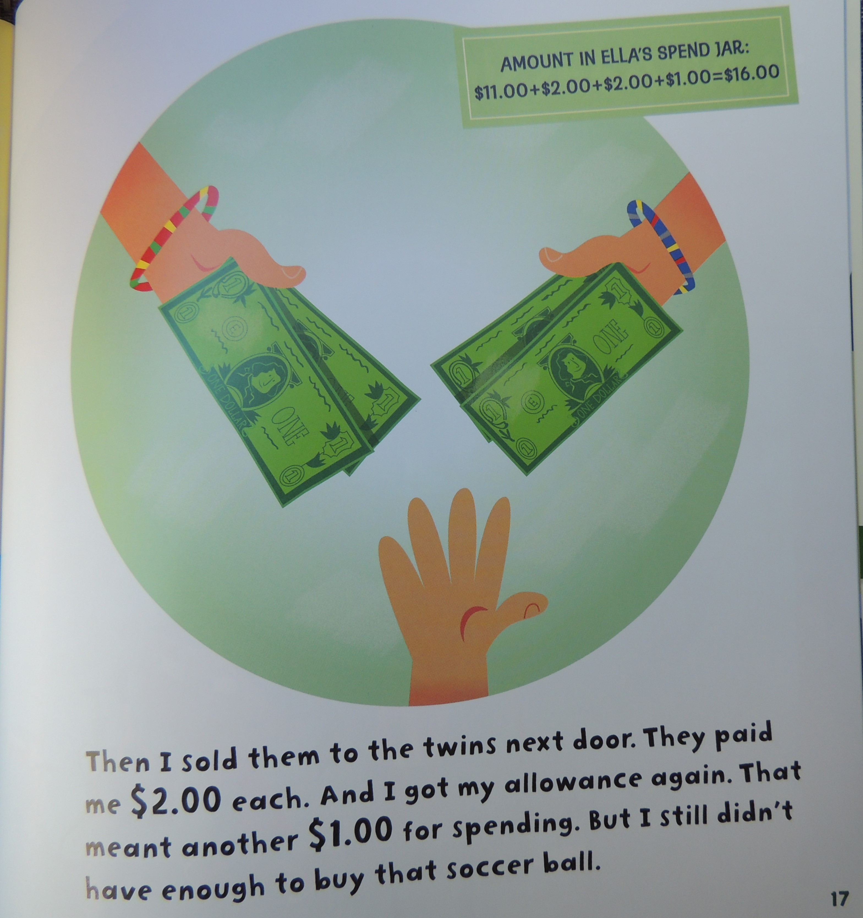

Slide 18
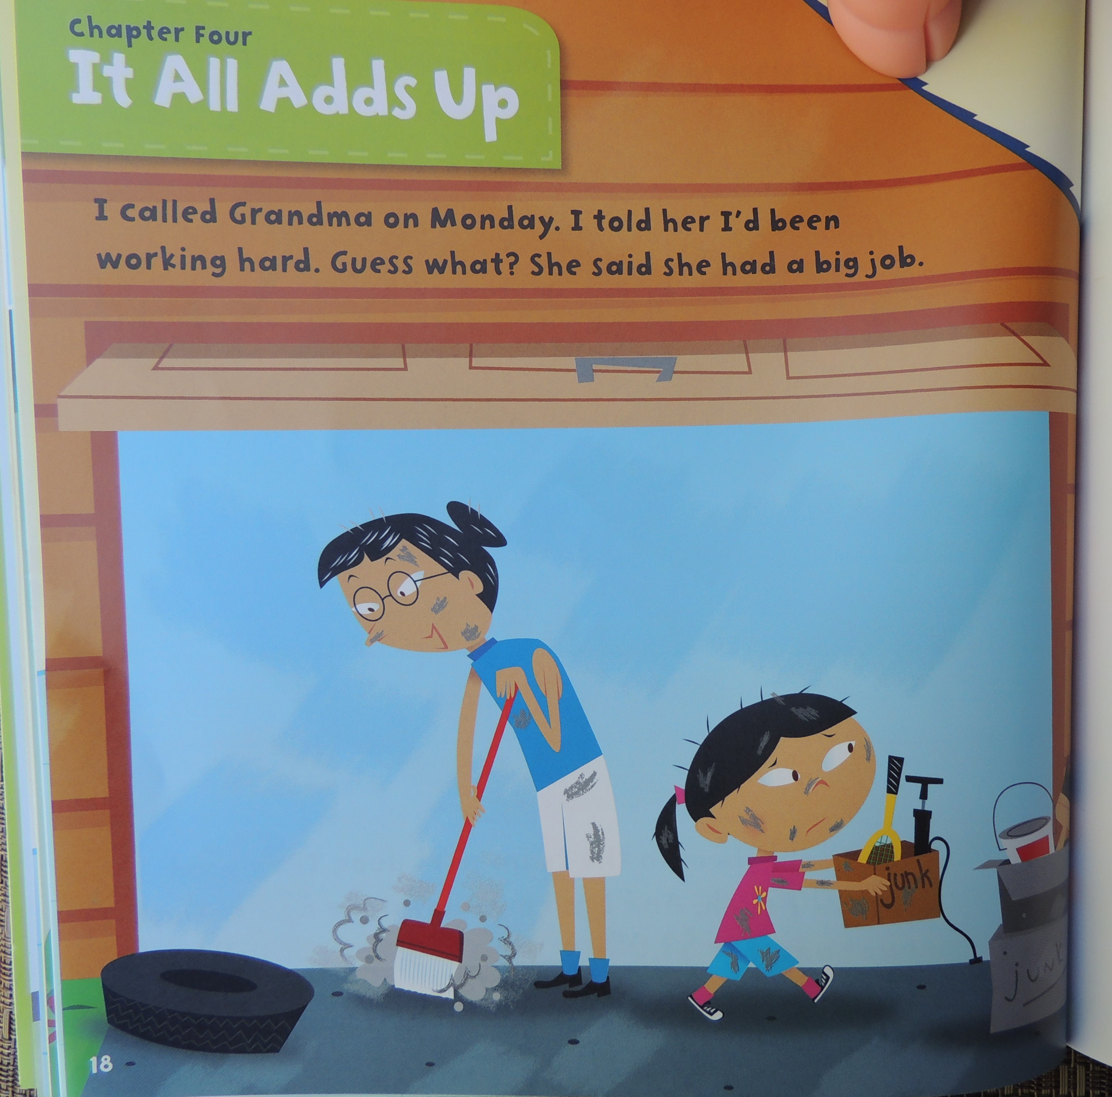

Slide 19
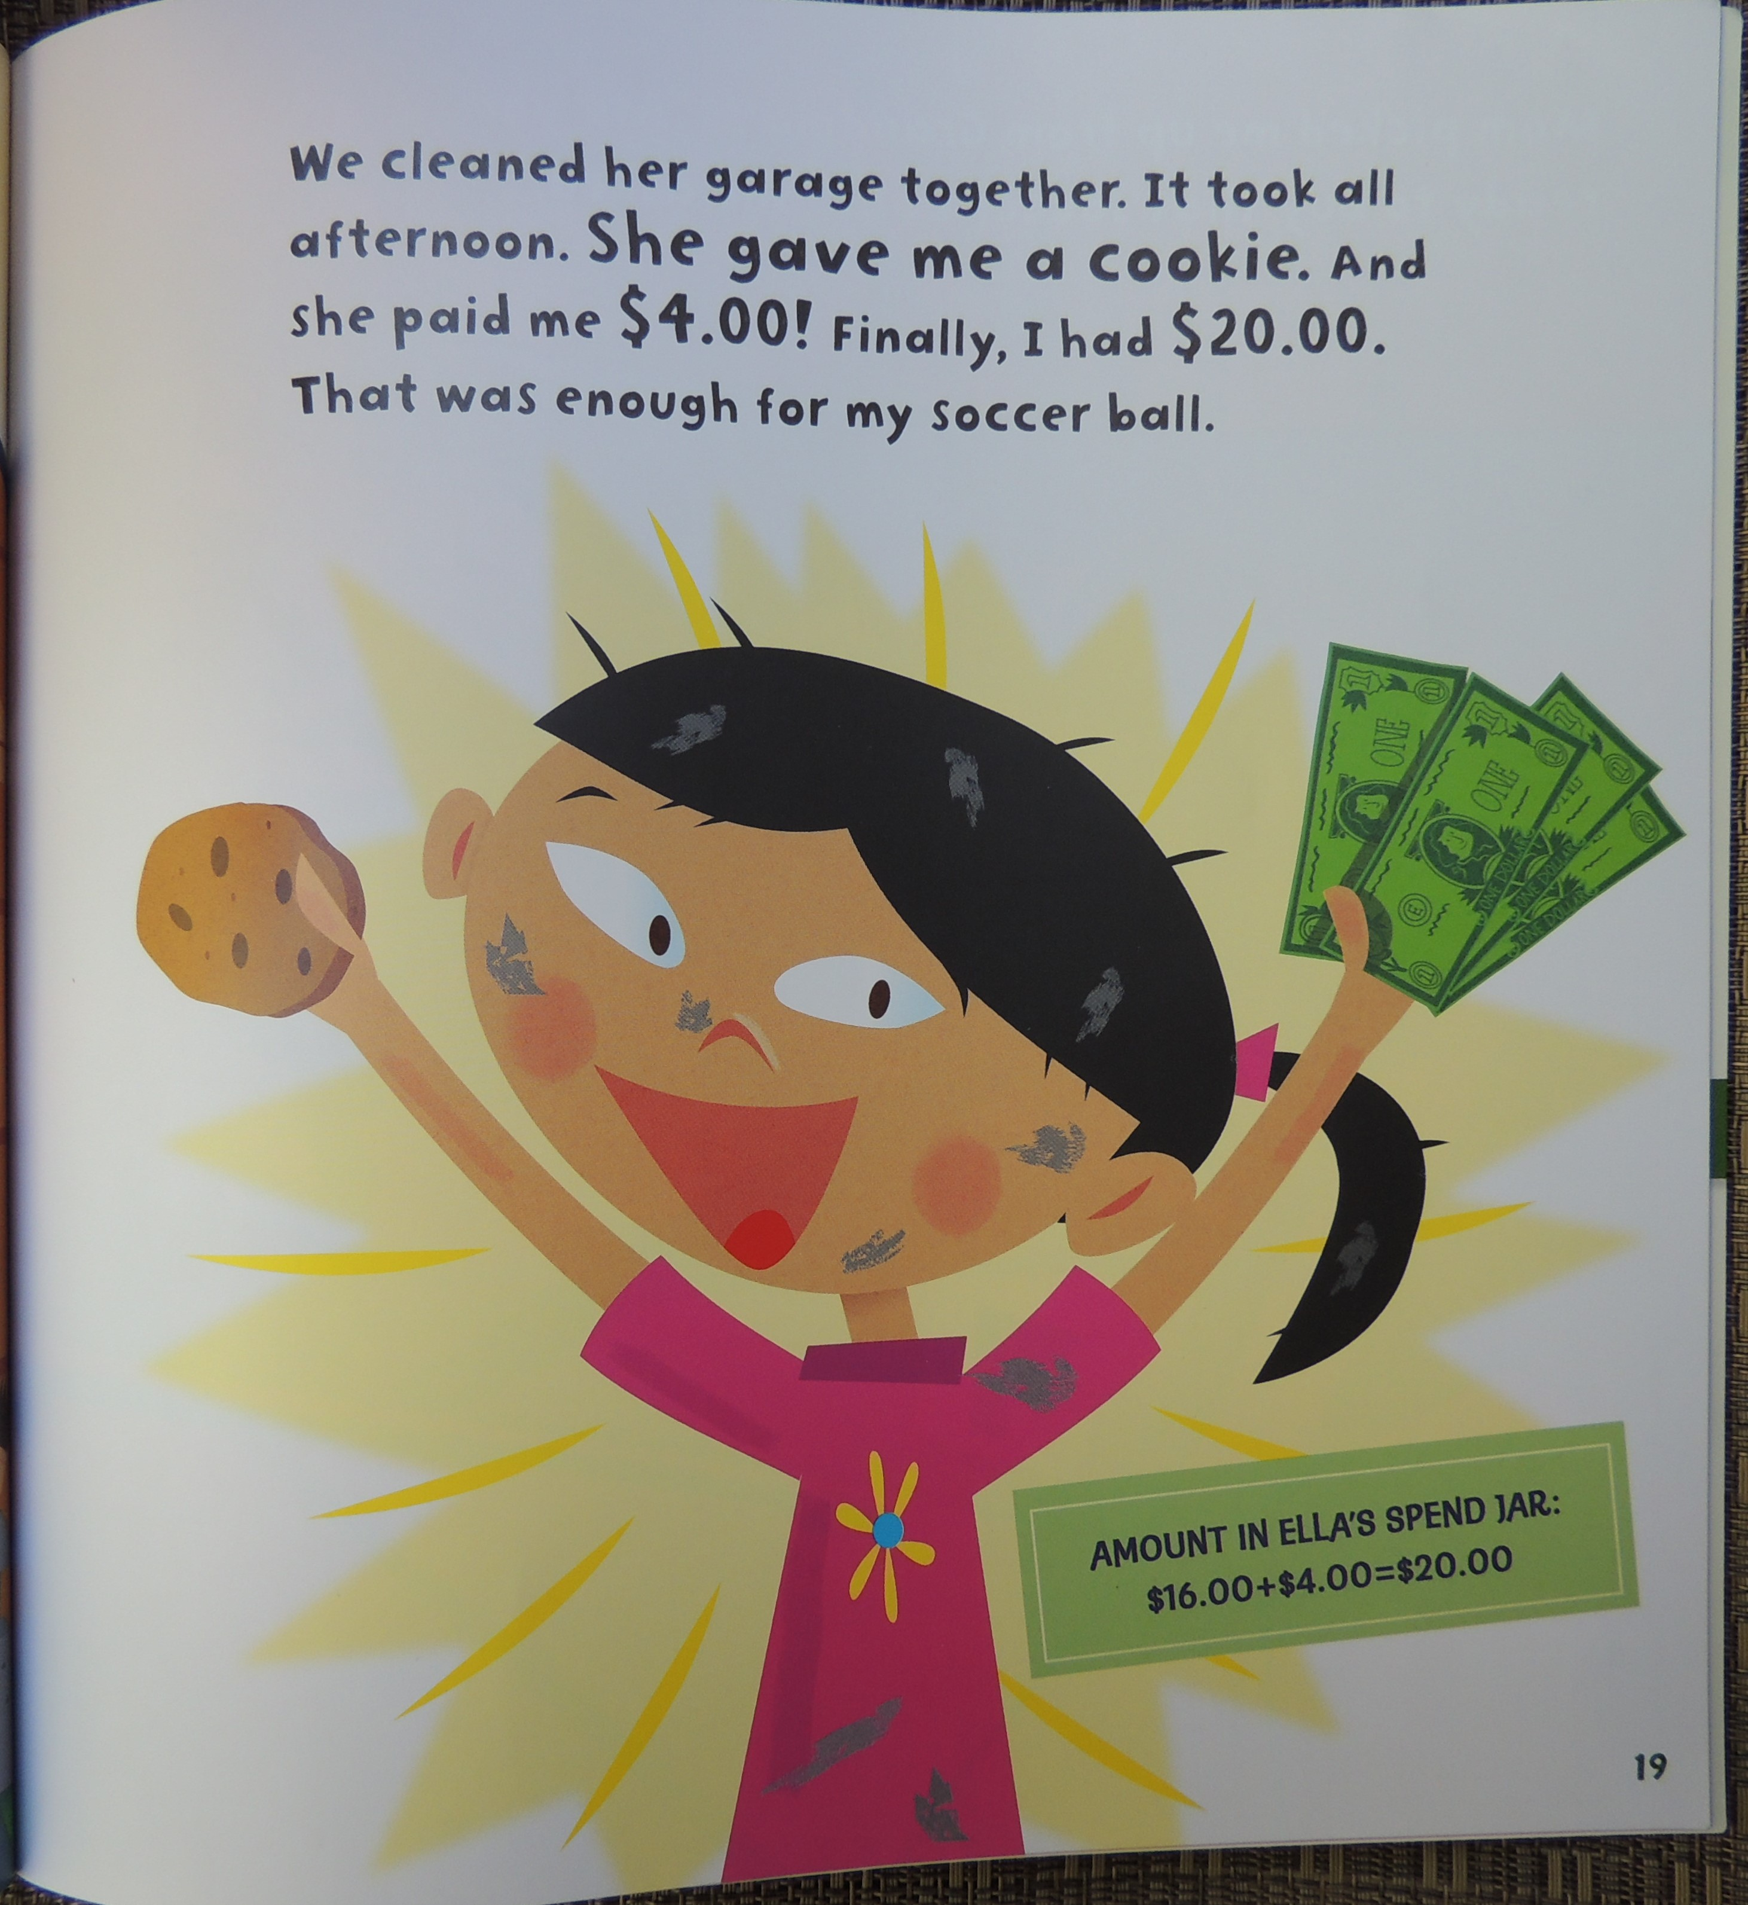

Slide 20
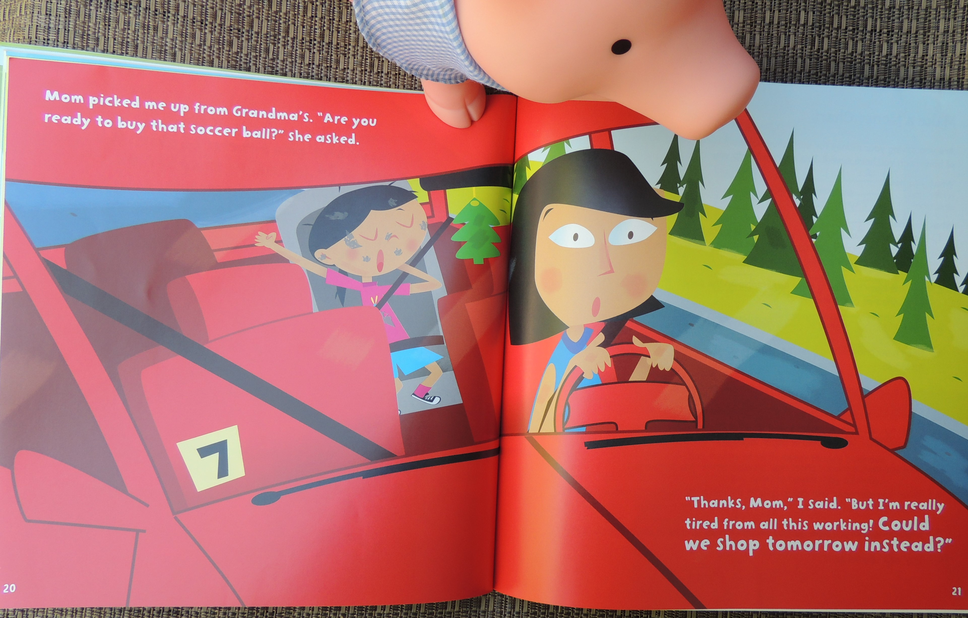

Slide 21
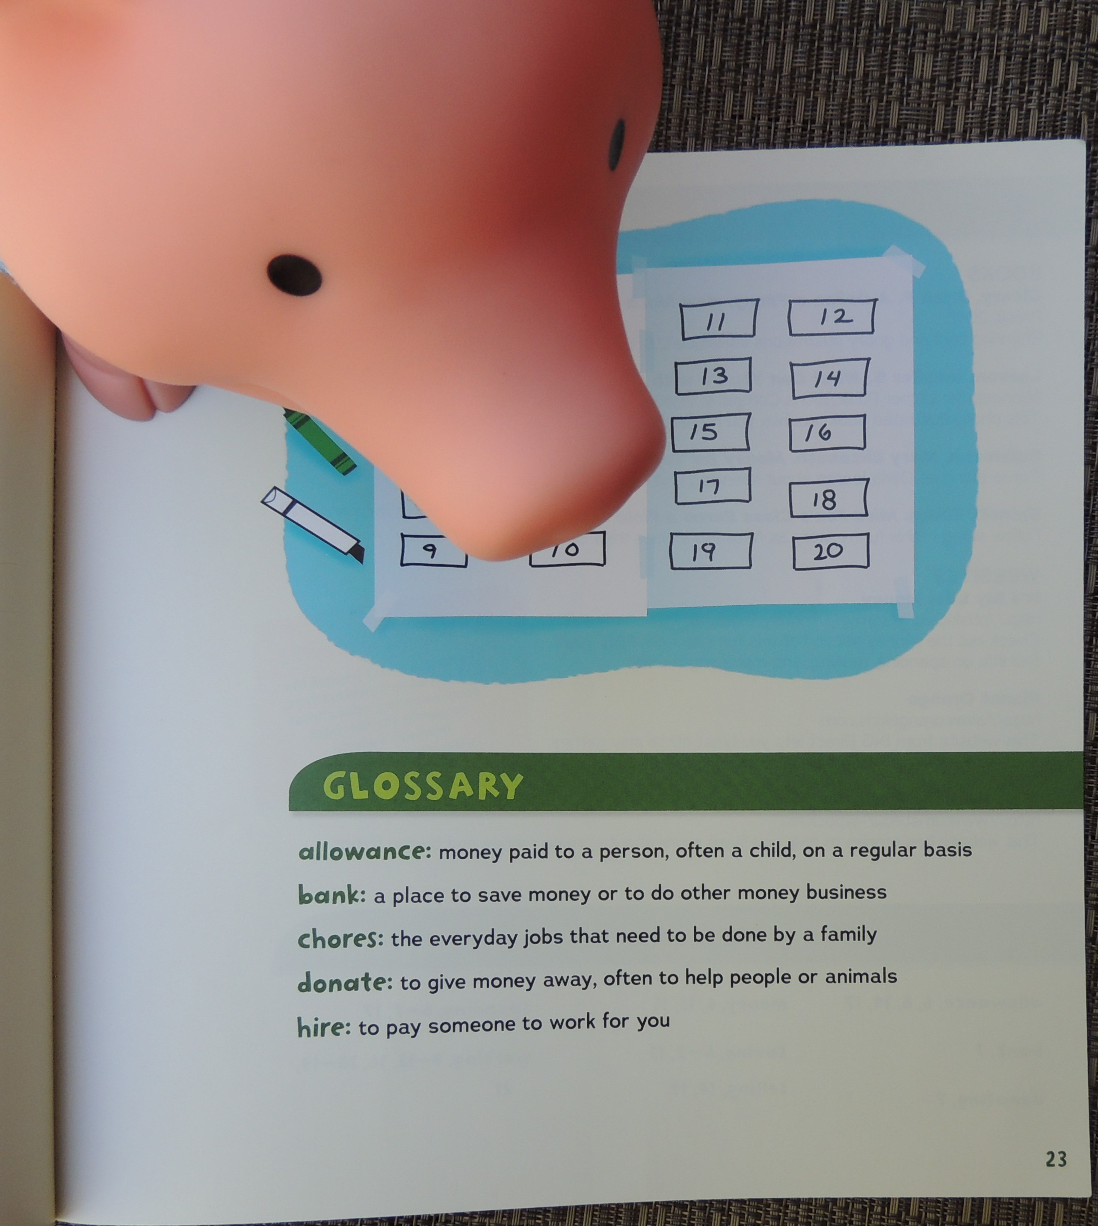

Slide 22
Questions to answer
What did Ella do in the story to earn money?
If you earn/earned money, what are some things you would save money for?
Notes:
Take a few minutes to answer these questions with your parent or teacher.
“What did Ella do in the story to earn money?” Listen to responses
“If you earn/earned money, what are some things you would save money for?” Listen to responses.

Slide 23
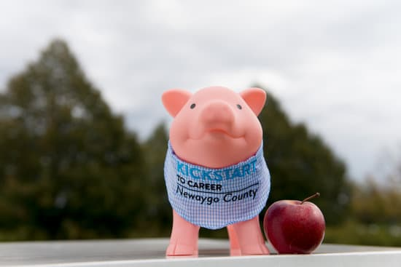
Worksheet directions
Draw a picture of a way you could earn money
Answer the three questions about earning and saving money
Give the completed worksheet to your teacher or parent
Receive the completion certificate from teacher or parent
Congrats! You’ve earned $50 into your Kickstart account.
Notes:
“Remember, you also have a Kickstart to Career account you can save your earned money in.”
Your teacher or parent is going to give you a worksheet to complete based on what we learned today.
You will start out by drawing a picture of a way you would earn money. Then you will be asked how much you think you could earn this year and how much of that money you could put in your Kickstart account to save for your future career. Finally, you will think about an adult in your life and share how that adult makes money.
After you are done completing the worksheet, your teacher or parent will collect the worksheet and hand you your certificate. $50 will be put in your Kickstart account for the hard work you did today learning about saving and spending. Thank you for letting Penny the piggy visit you virtually today! We hope to see you soon.

