Slide 1
Incentive workshop
Notes:
“Hello. My name is Mr./Ms./Mrs. ____.” You may use your fist name. Keep in mind that students are used to addressing adults in school as Mr., Ms., or Mrs.
Introduce the mascot “I am here today with Kickstart to Career Newaygo County. I have brought my friend, Penny the Piggy Bank.” (Show Penny to the students, welcome them to greet her.)
Let the students know that you will be working with them today to find out what it means to save money and why we should do it.

Slide 2
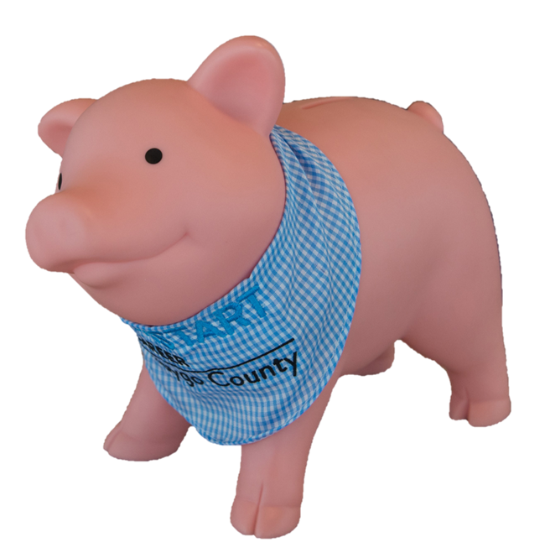
What do you want to be when you grow up?
Notes:
“Does anyone already know what they want to be when they grow up? Take a minute to share with your teacher or parent” If you didn’t get the chance to share, here are some ideas of different jobs (teacher, firefighter, construction worker, musician, doctor, and scientist).
Explain the connection between needing money for college, uniform, etc. based on the career’s students mention (ex. What do you think you will need to become a doctor?). “How do you plan on saving for those things?”
Take a minute to share with your teacher or parent”

Slide 3
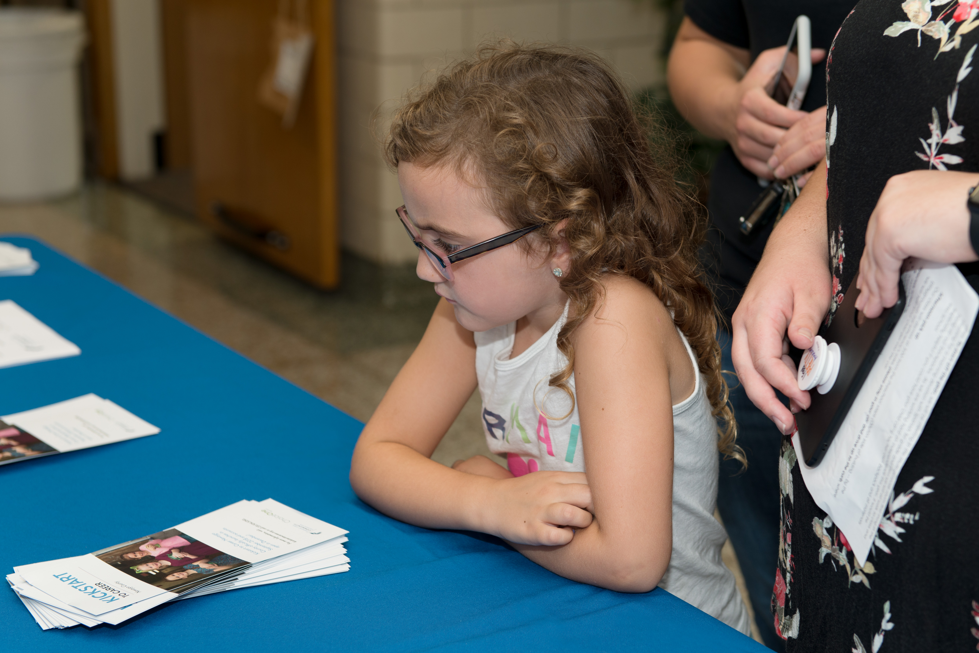
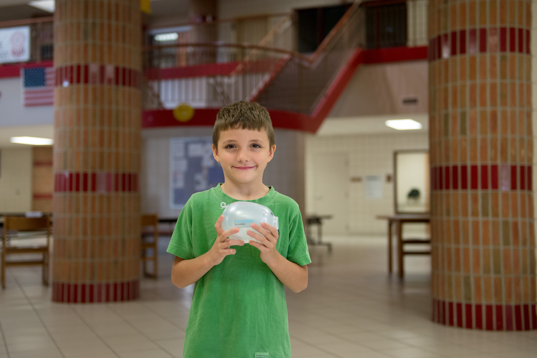
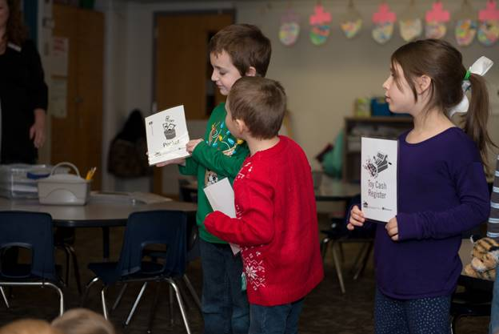
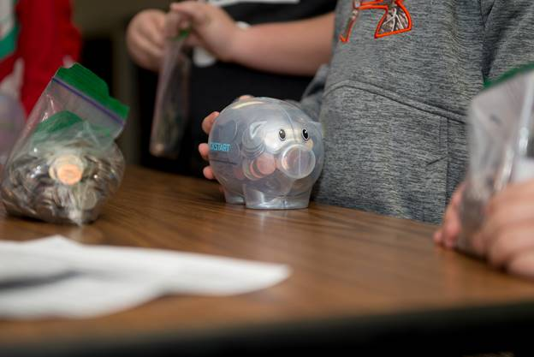
Savings account program
Notes:
“Thanks to the community foundation, you have a Kickstart to Career account. Explain what the program is.
“It’s great that you are already saving for your future career with your Kickstart account! Let’s talk a little more about savings and spending.”
Pictures: FPS, FCS, WCPS, & GPS

Slide 4
Needs and wants video
Notes:
***ACTION: Click the speaker icon in the lower left corner first, then click the embedded video when speaking is complete***
Saving money means you are keeping it safe for a later time
Spending money means you use your money to buy something
“When you spend money, it falls under two categories – want and need. We’re going to watch a short video about wants and needs.”
Show video clip: https://www.youtube.com/watch?v=dVAxj5zX4zQ

Slide 5
Want and need
Dog / Perro
Water / Agua
A dog is considered a want because it is something you could live without.
Water is considered a need because you must have it to survive.
Notes:
As the video told us, a need is something you must have to survive like clothing, shelter, or food. A want is something you would like to have but could live without.

Slide 6
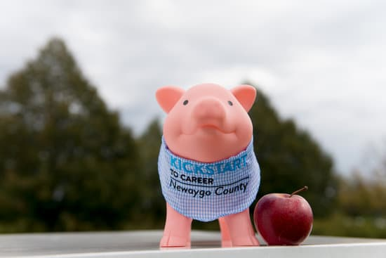
Worksheet directions
Draw a picture of what you want to be when you grow up
Select the pictures as a want or need
Give your completed worksheet to teacher or parent
Receive completion certificate from teacher or parent
Congrats! You’ve earned $50 into your Kickstart account.
Notes:
Your teacher or parent is going to give you a worksheet to complete based on what we learned today.
You will start out by drawing a picture of what you want to be when you grow up. Then you will be asked if you will put money into your Kickstart account for your future. Finally, you will look at some pictures and write whether the picture is a want or a need.
After you are done, your teacher or parent will collect the worksheet and later you will receive a special certificate. $50 will be put in your Kickstart account for the hard work you did today learning about saving and spending. Thank you for letting Penny the piggy visit you virtually today! We hope to see you soon.

